Slide 1




Welcome
MIP…
WTF!?!?

Slide 2


Slide 3







In a world without boundaries, data lives and travels everywhere
OPPORTUNITY

Slide 4
You have told us
“My data is scattered across sources and the data continues to grow”
“I can’t apply unified policies across various data sources or to a specific repository”
“How do I protect sensitive information such as sensitive PII data across my enterprise?”
“I need complete coverage of all my devices and applications”
“I want data governance to be automatic - not something I have to think about”
“When enforcing compliance our business users’ productivity is disrupted”
“How do I find only relevant data when I need it?”

Slide 5

Microsoft’s information protection solutions helps you protect sensitive data throughout the lifecycle – inside and outside the organization

Slide 6
Protect your sensitive data – wherever it lives or travels
Microsoft Information Protection
Discover
Classify
Protect
Monitor
Across
Devices
Apps
Cloud services
On-premises
Notes:
EMS Overview
© 2014 Microsoft Corporation. All rights reserved. Microsoft, Windows, Surface and other product names are or may be registered trademarks and/or trademarks in the U.S. and/or other countries. The information herein is for informational purposes only and represents the current view of Microsoft Corporation as of the date of this presentation. Because Microsoft must respond to changing market conditions, it should not be interpreted to be a commitment on the part of Microsoft, and Microsoft cannot guarantee the accuracy of any information provided after the date of this presentation. MICROSOFT MAKES NO WARRANTIES, EXPRESS, IMPLIED OR STATUTORY, AS TO THE INFORMATION IN THIS PRESENTATION.
2/7/2019
6

Slide 7

Data protection & data governance go hand-in-hand
Comprehensive policies to protect and govern your most important data – throughout its lifecycle
Unified approach
Unified approach to discover, classify & label
Automatically apply policy-based actions
Proactive monitoring to identify risks
Broad coverage across locations
Discover
Classify
Label
Apply label
Sensitivity
Retention
Encryption
Restrict Access
Watermark
Header/Footer
Retention
Deletion
Records Management
Archiving
Monitor
Sensitive data discovery
Data at risk
Policy violations
Policy recommendations
Proactive alerts

Slide 8
Microsoft Information Protection – the way it was
Office 365
Information Protection
Windows
Information Protection
Azure
Information Protection
What
Preserve or remediate emails & documents
Classify & Protect
emails & documents
Protect files and documents
Where
Office 365 Apps & Services
Office Clients, 3rd party Apps & Services, On Premises
Windows Clients & Devices
How
Office 365 Security Console
Intune Portal
AIP Portal

Slide 9
Microsoft Information Protection – starting today
Office 365
Information Protection
Windows
Information Protection
Azure
Information Protection
What
Consistent content detection and classification to protect and preserve sensitive data
Where
Office 365 apps & services, Windows clients & desktops, mobile, on premises + 3rd party apps and services
How
Microsoft 365 Security and Compliance Center

Slide 10
Comprehensive set of capabilities
AZURE INFORMATION PROTECTION
Classify, label & protect files – beyond Office 365, including on-premises & hybrid
CONDITIONAL ACCESS
Control access to files based on policy, such as identity, machine configuration, geo location
MICROSOFT CLOUD APP SECURITY
Visibility into 15k+ cloud apps, data access & usage, potential abuse
OFFICE APPS
Protect sensitive information while working in Excel, Word, PowerPoint, Outlook
OFFICE 365 DATA LOSS PREVENTION
Prevent data loss across Exchange Online, SharePoint Online, OneDrive for Business
MICROSOFT INFORMATION PROTECTION
SHAREPOINT & GROUPS
Protect files in libraries and lists
OFFICE 365 MESSAGE ENCRYPTION
Send encrypted emails in Office 365 to anyone inside or outside of the company
AZURE SECURITY CENTER INFORMATION PROTECTION
Classify & label sensitive structured data in Azure SQL, SQL Server and other Azure repositories
Discover | Classify | Protect | Monitor
WINDOWS INFORMATION PROTECTION
Separate personal vs. work data on Windows 10 devices, prevent work data from traveling to non-work locations
SDK FOR PARTNER ECOSYSTEM & ISVs
Enable ISVs to consume labels, apply protection
OFFICE 365 ADVANCED DATA GOVERNANCE
Apply retention and deletion policies to sensitive and important data in Office 365
ADOBE PDFs
Natively view and protect PDFs on Adobe Acrobat Reader

Slide 11
Discover
Classify
Protect
Monitor
Scan & detect sensitive data based on policy
Classify and label data based on sensitivity
Apply protection actions, including encryption, access restrictions

Slide 12




a
CLOUD & SaaS APPS
Office 365, Microsoft Cloud App Security
Discover and classify sensitive information
DEVICES
No matter where it’s created, modified or shared
Office apps, Windows Information Protection
ON PREMISES
AIP scanner

Slide 13

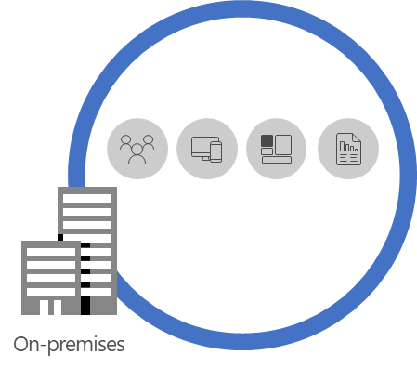
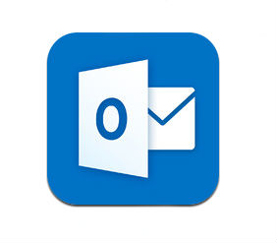


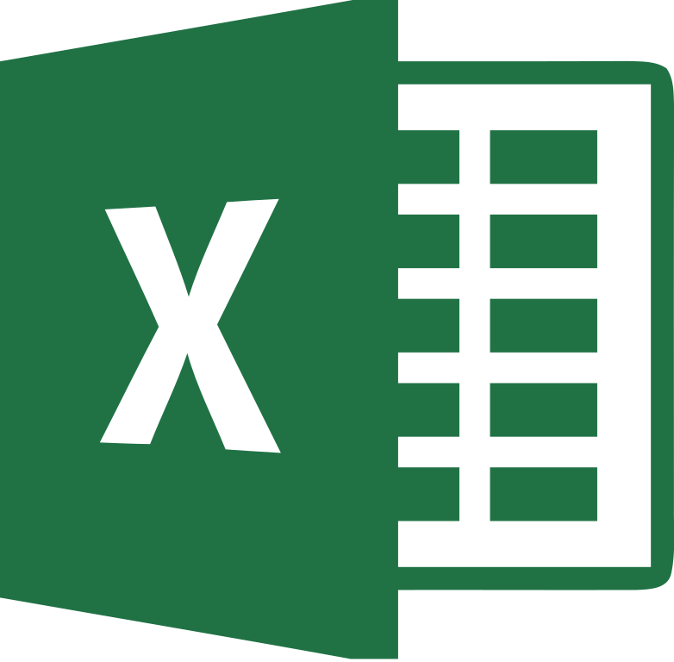
Discover & Classify across Microsoft Services
Consistent Auto Classification across Microsoft services
Native integration in content pipeline and substrate
Deep Content Scanning with 90+ built-in sensitive types
Fully extensible scanning with custom type support
NEW GDPR template with EU sensitive types
NEW Custom sensitive type authoring and fine tuning
NEW Exact Data Match based classification
NEW Image classification with OCR
Coming Soon
AIP Scanner
Microsoft Cloud App Security
Azure Service
Service Integration
Client apps
On Premises
Data Classification Service (DCS)
Uniform Content Discovery & Classification

Slide 14
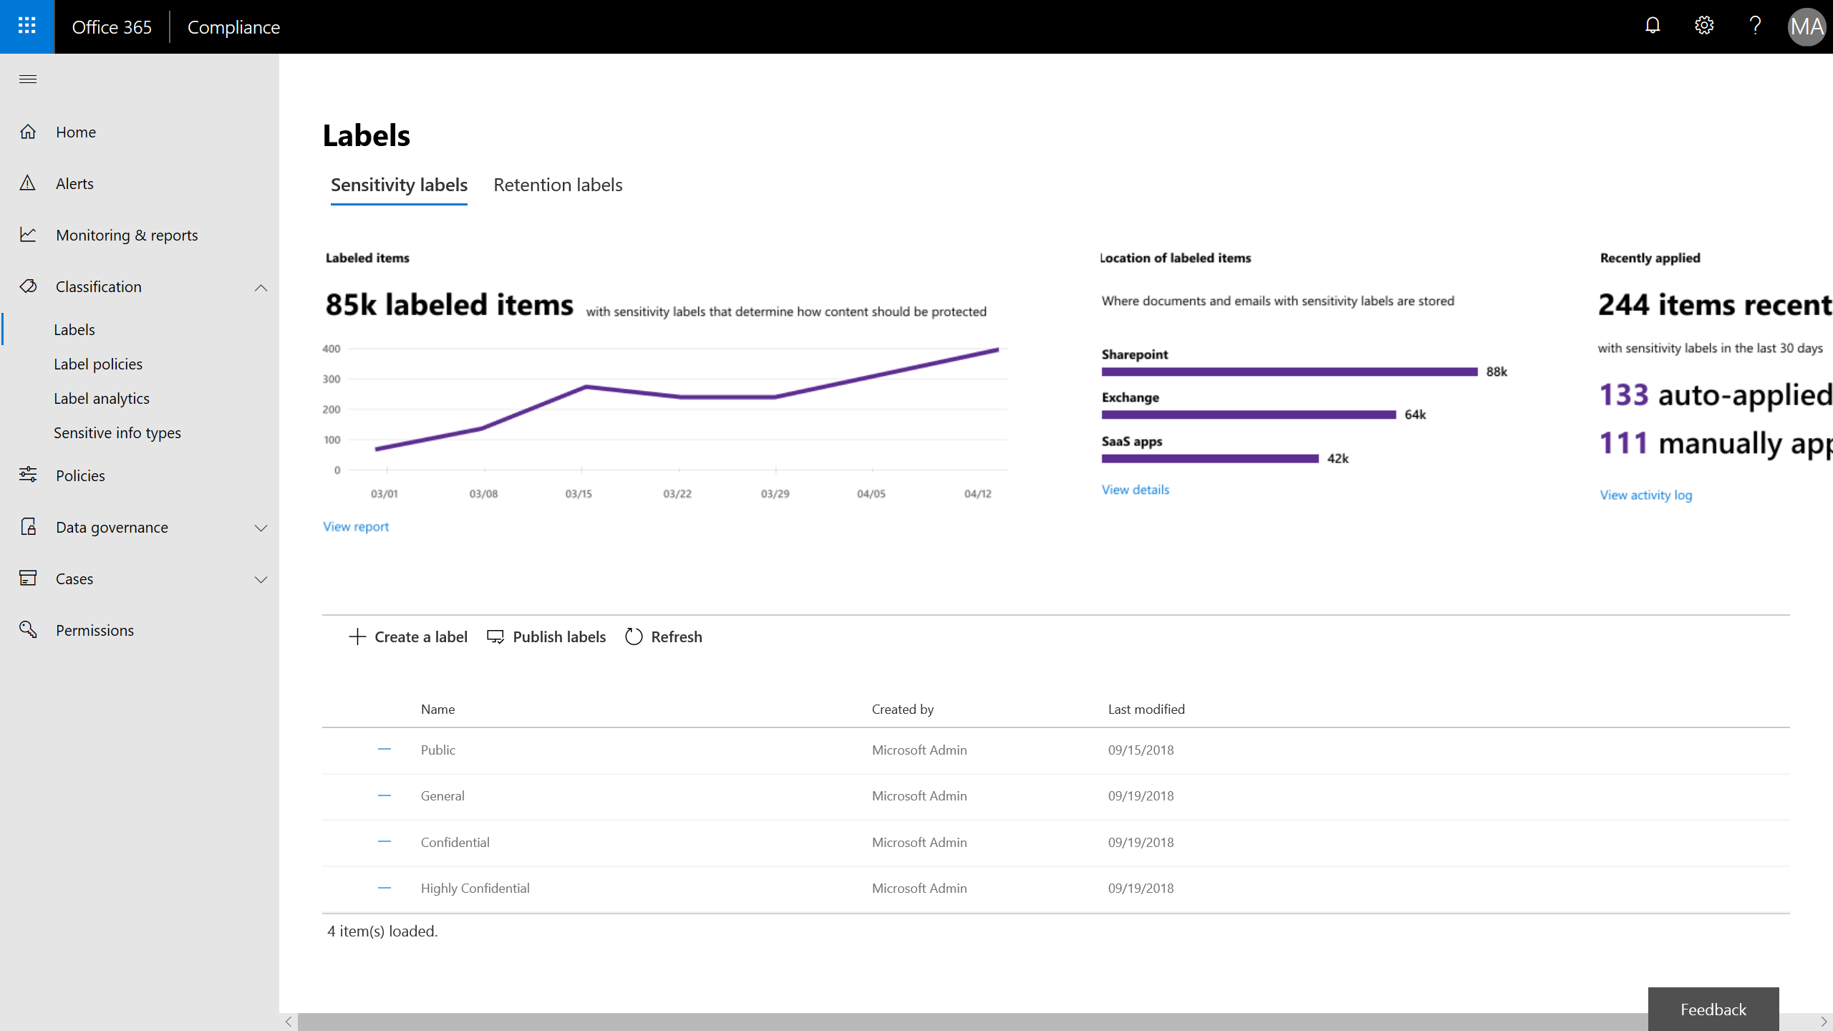
Unified labeling across Office 365, Azure and Windows Information Protection
Centralized management
Configure and manage labels across apps and services in Office, Azure and Windows – all from the Security & Compliance Center
Unified classification
Uniform content classification to protect and preserve data across Office, Azure, Windows
Consistent across M365 & extensible to 3rd party
Consistent integration and experience across M365 apps & services. Extensible to 3rd party apps & solutions

Slide 15

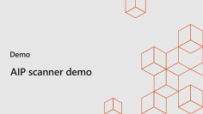
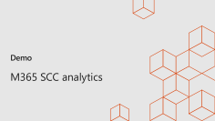
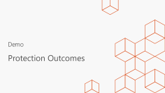
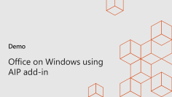
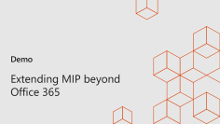
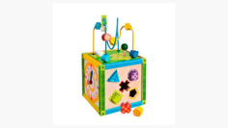

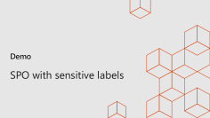
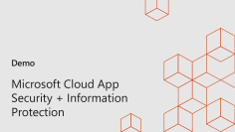
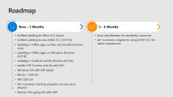
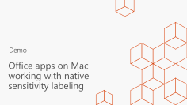
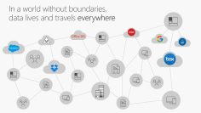

Slide 16
Demo
Protection Outcomes

Slide 17



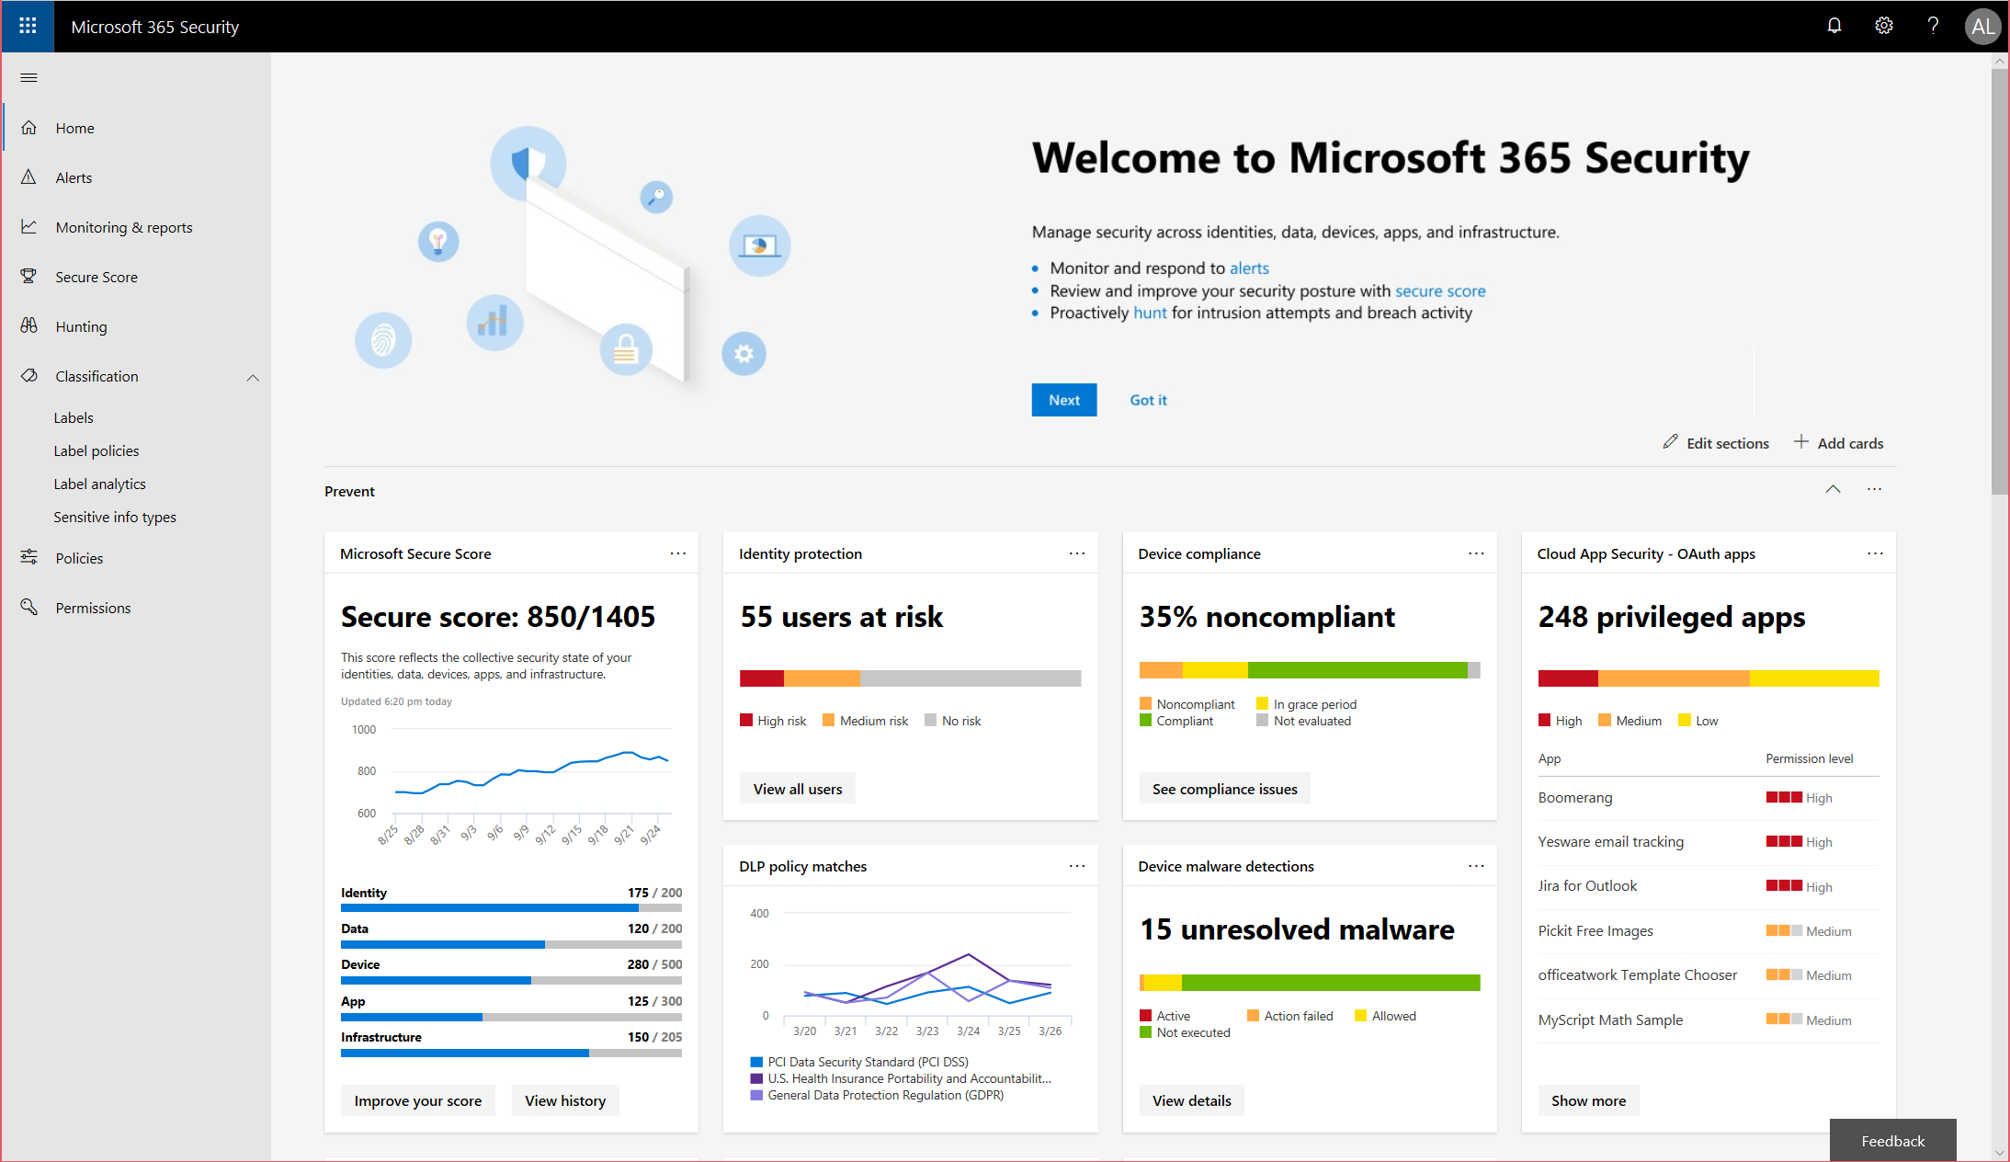
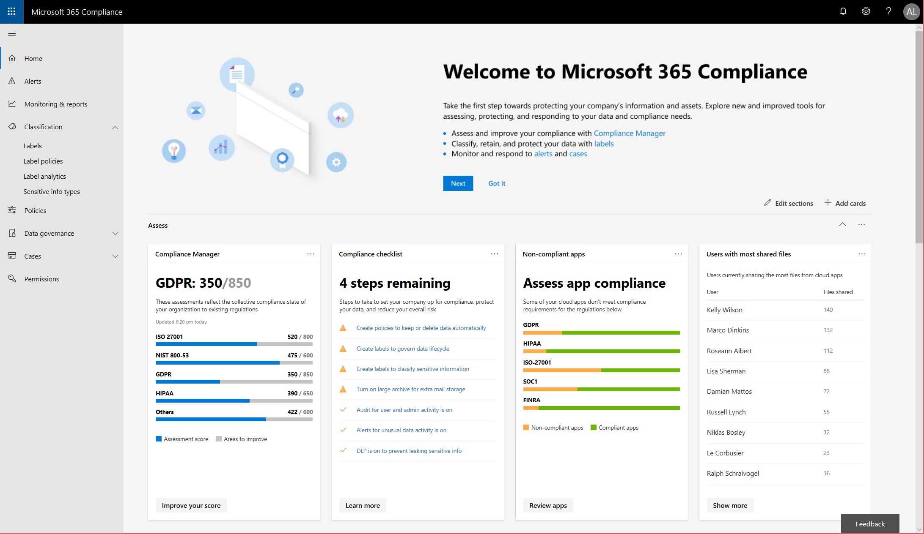
New Microsoft 365 Specialized Workspaces
Microsoft 365 Security Center
Microsoft 365 Compliance Center
security.microsoft.com
compliance.microsoft.com

Slide 18
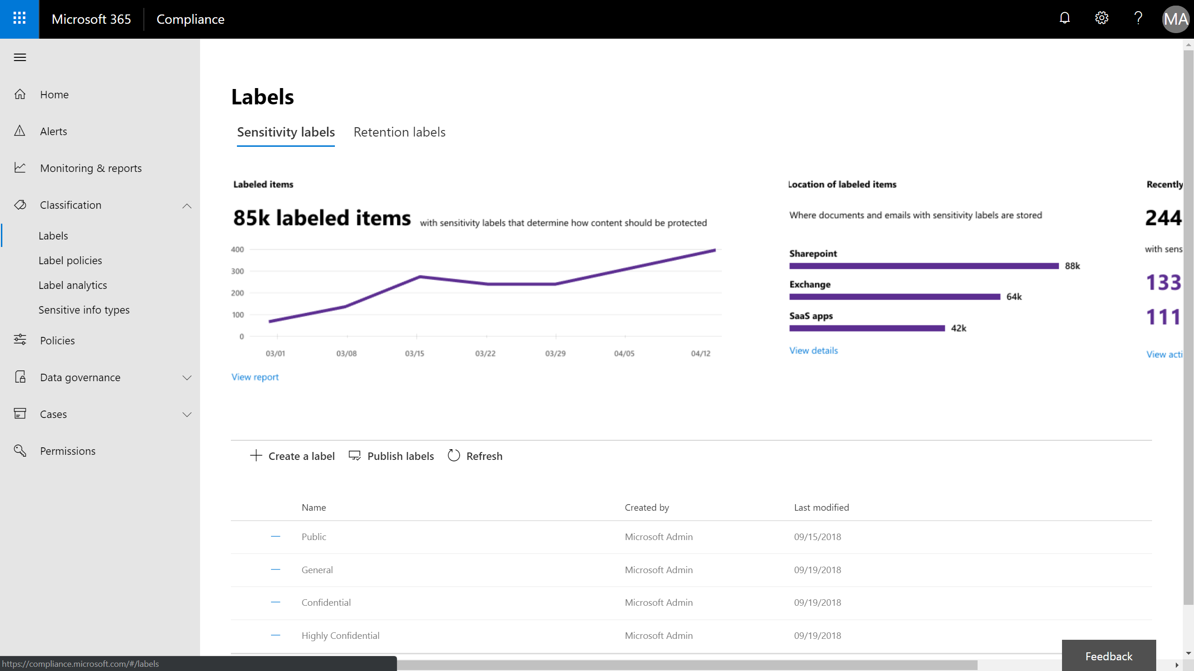
Available Now

Slide 19
Available Now

Slide 20
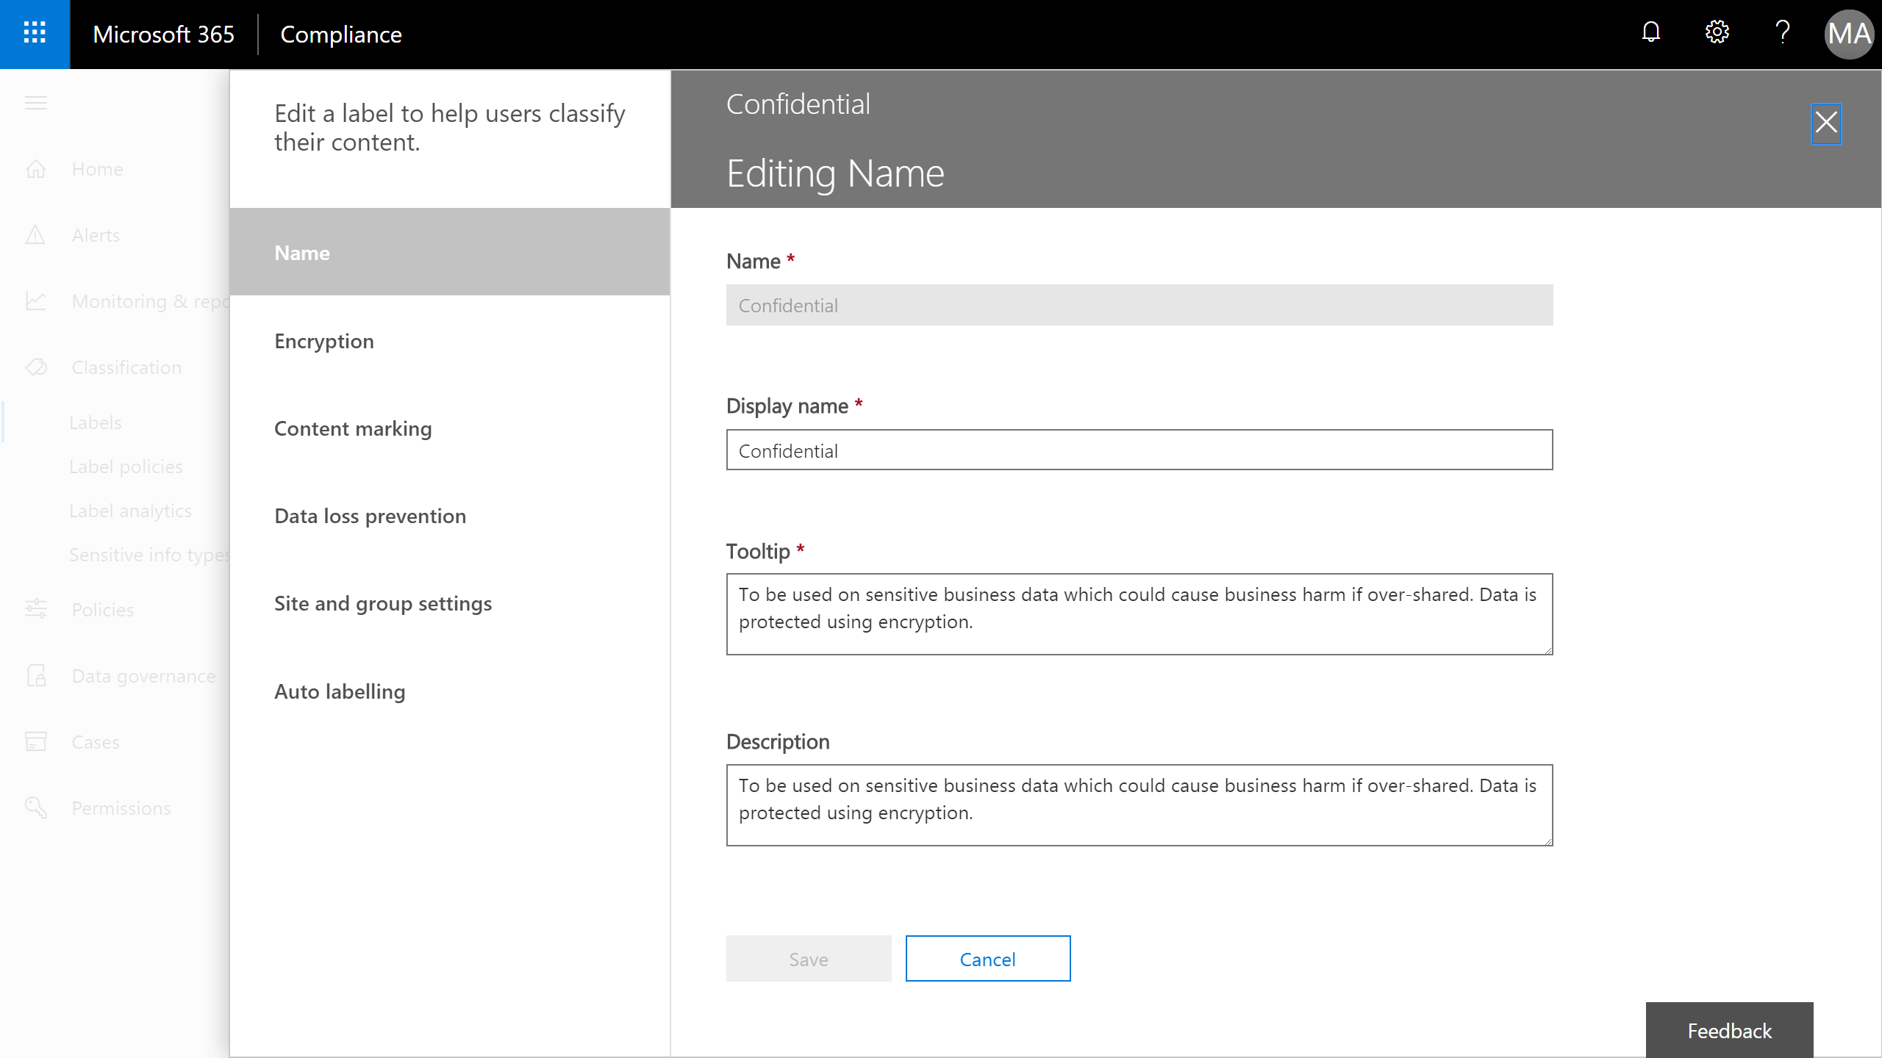

Slide 21
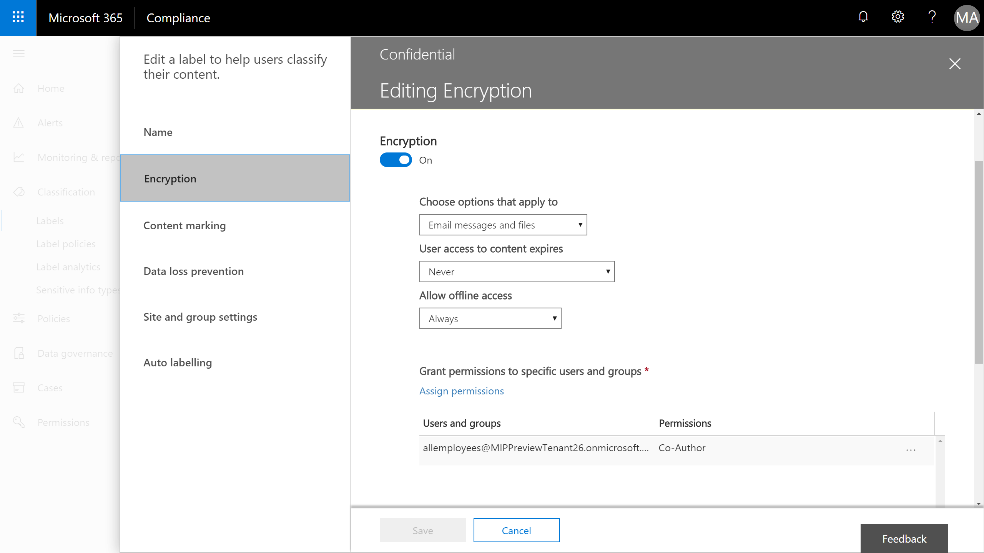

Slide 22
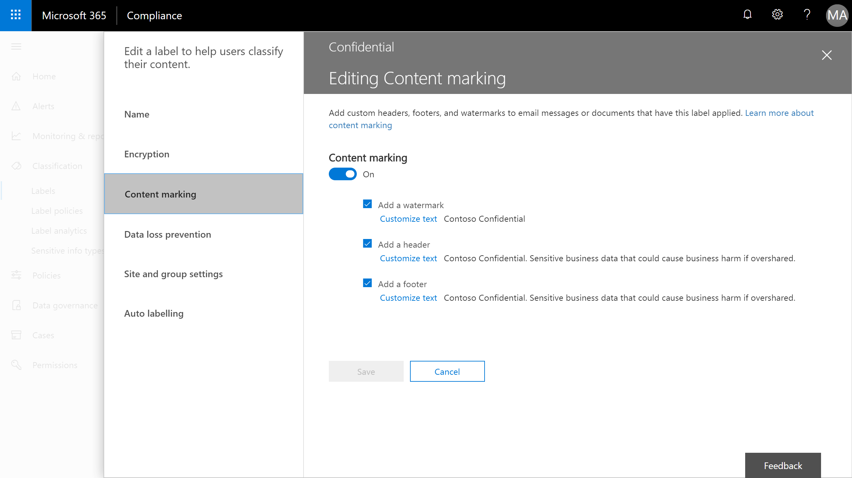

Slide 23
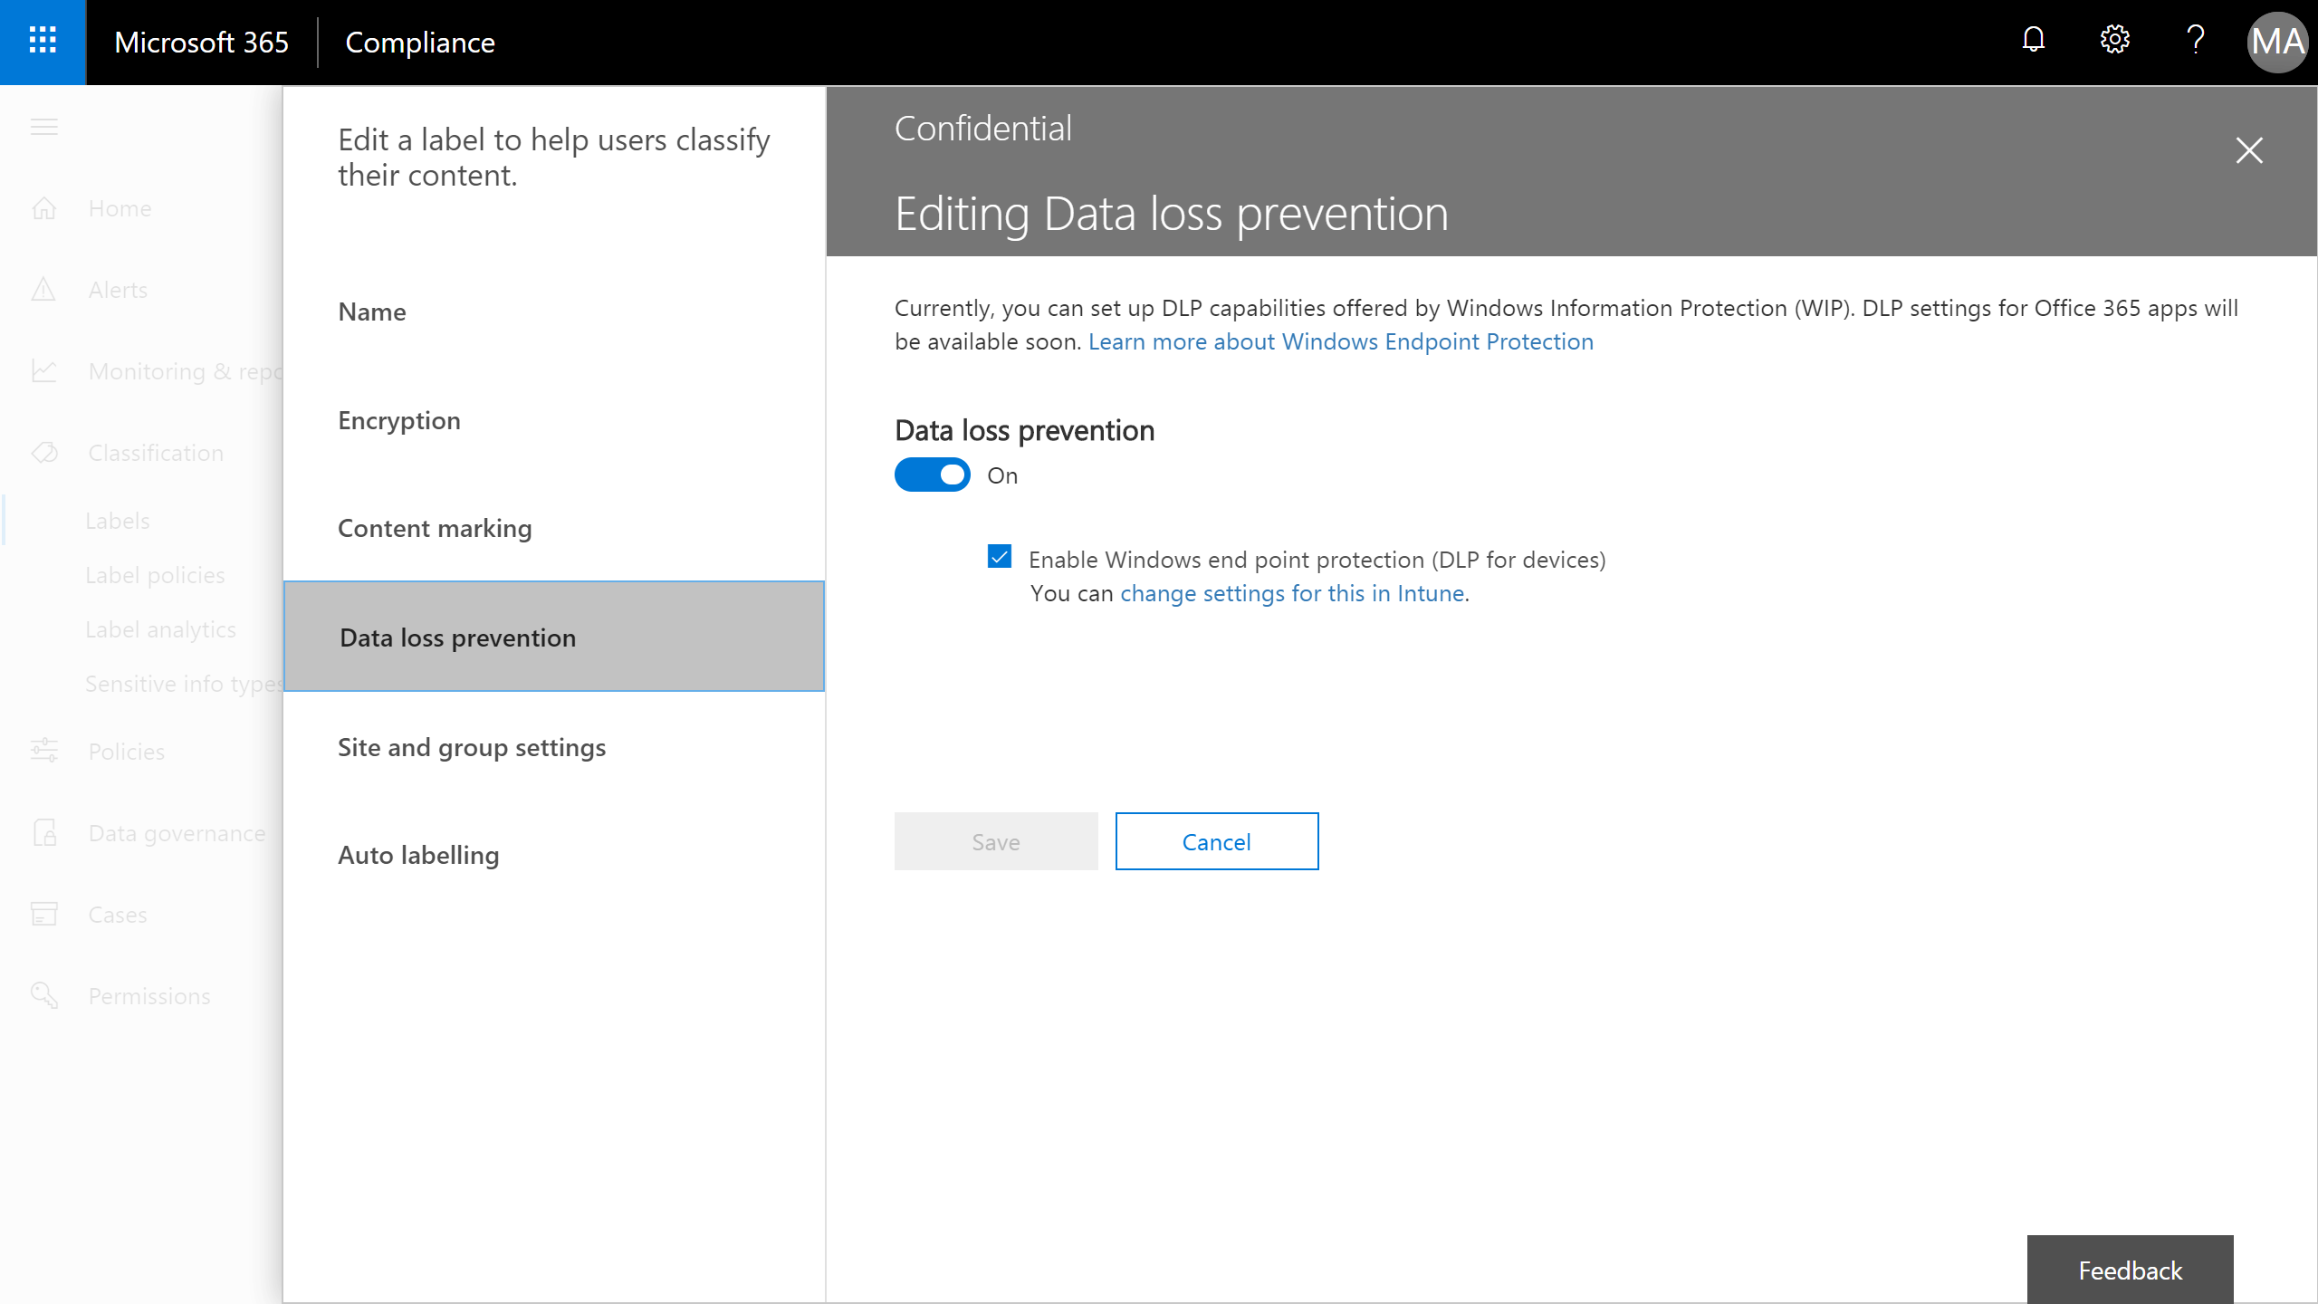

Slide 24
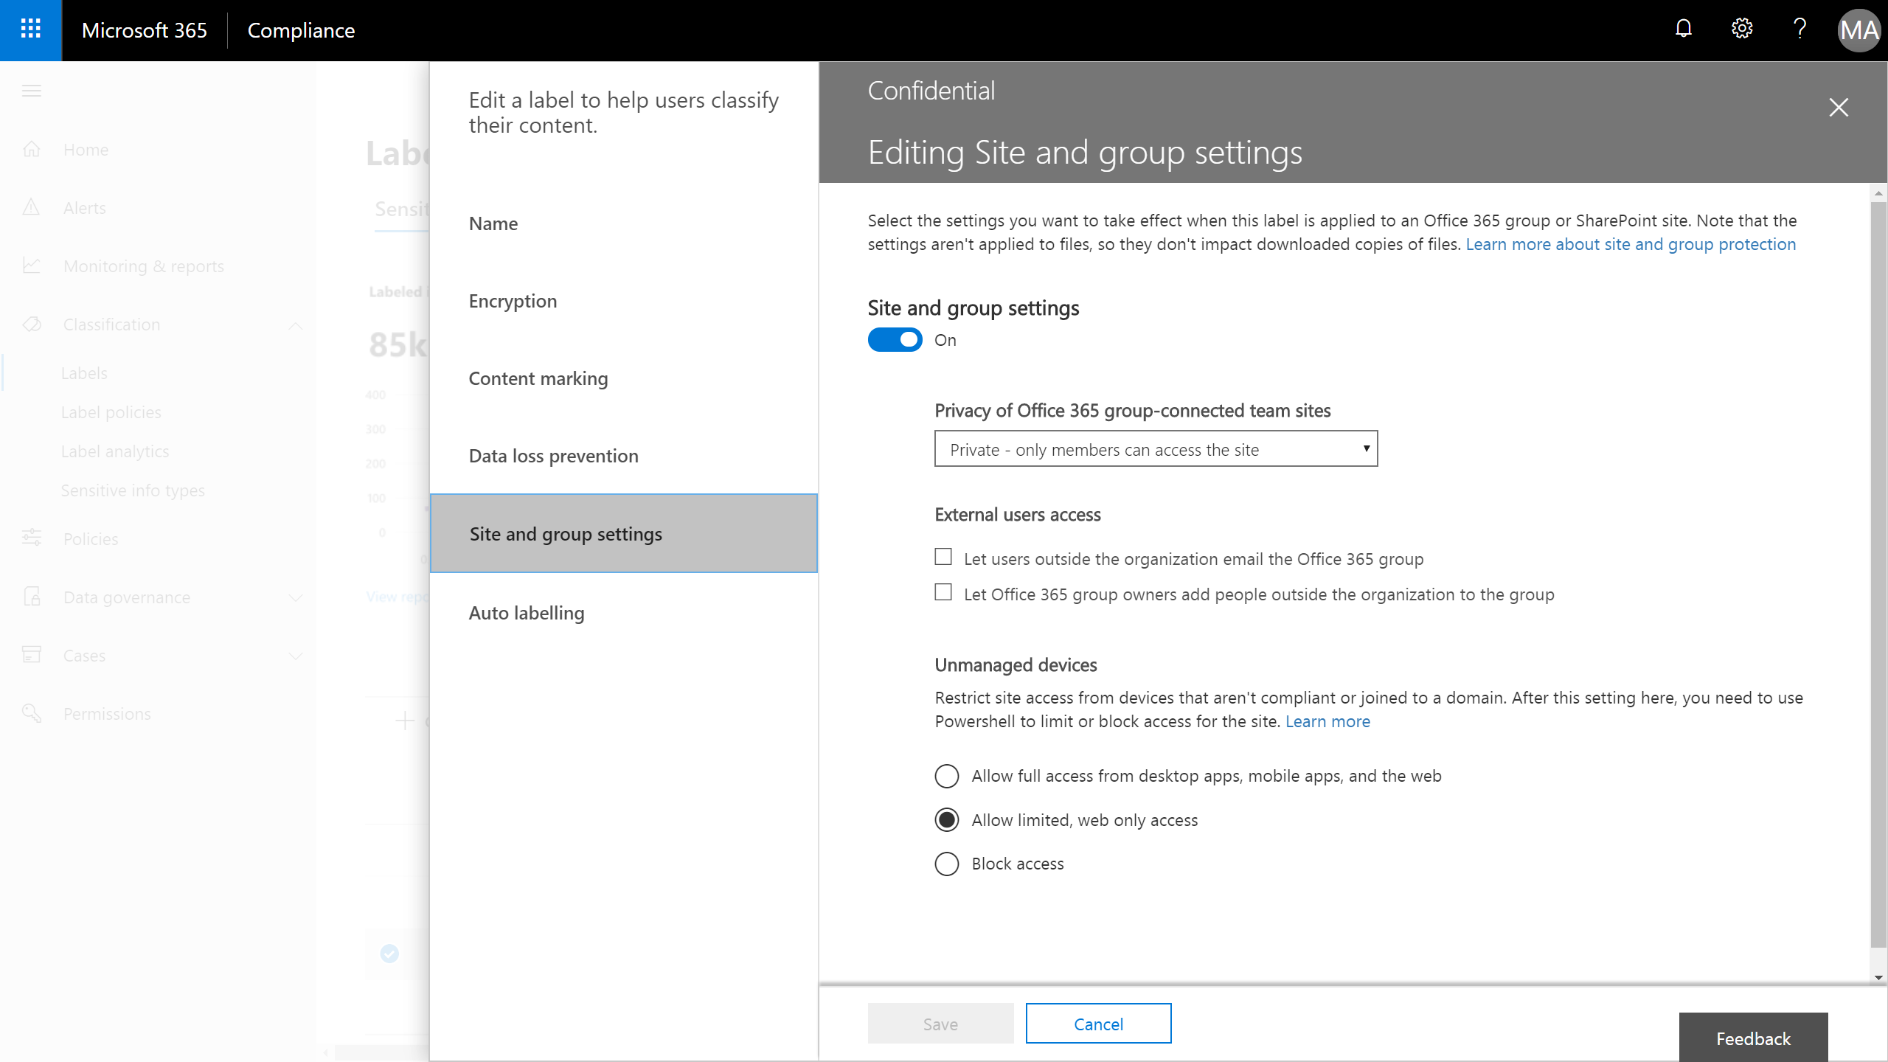

Slide 25
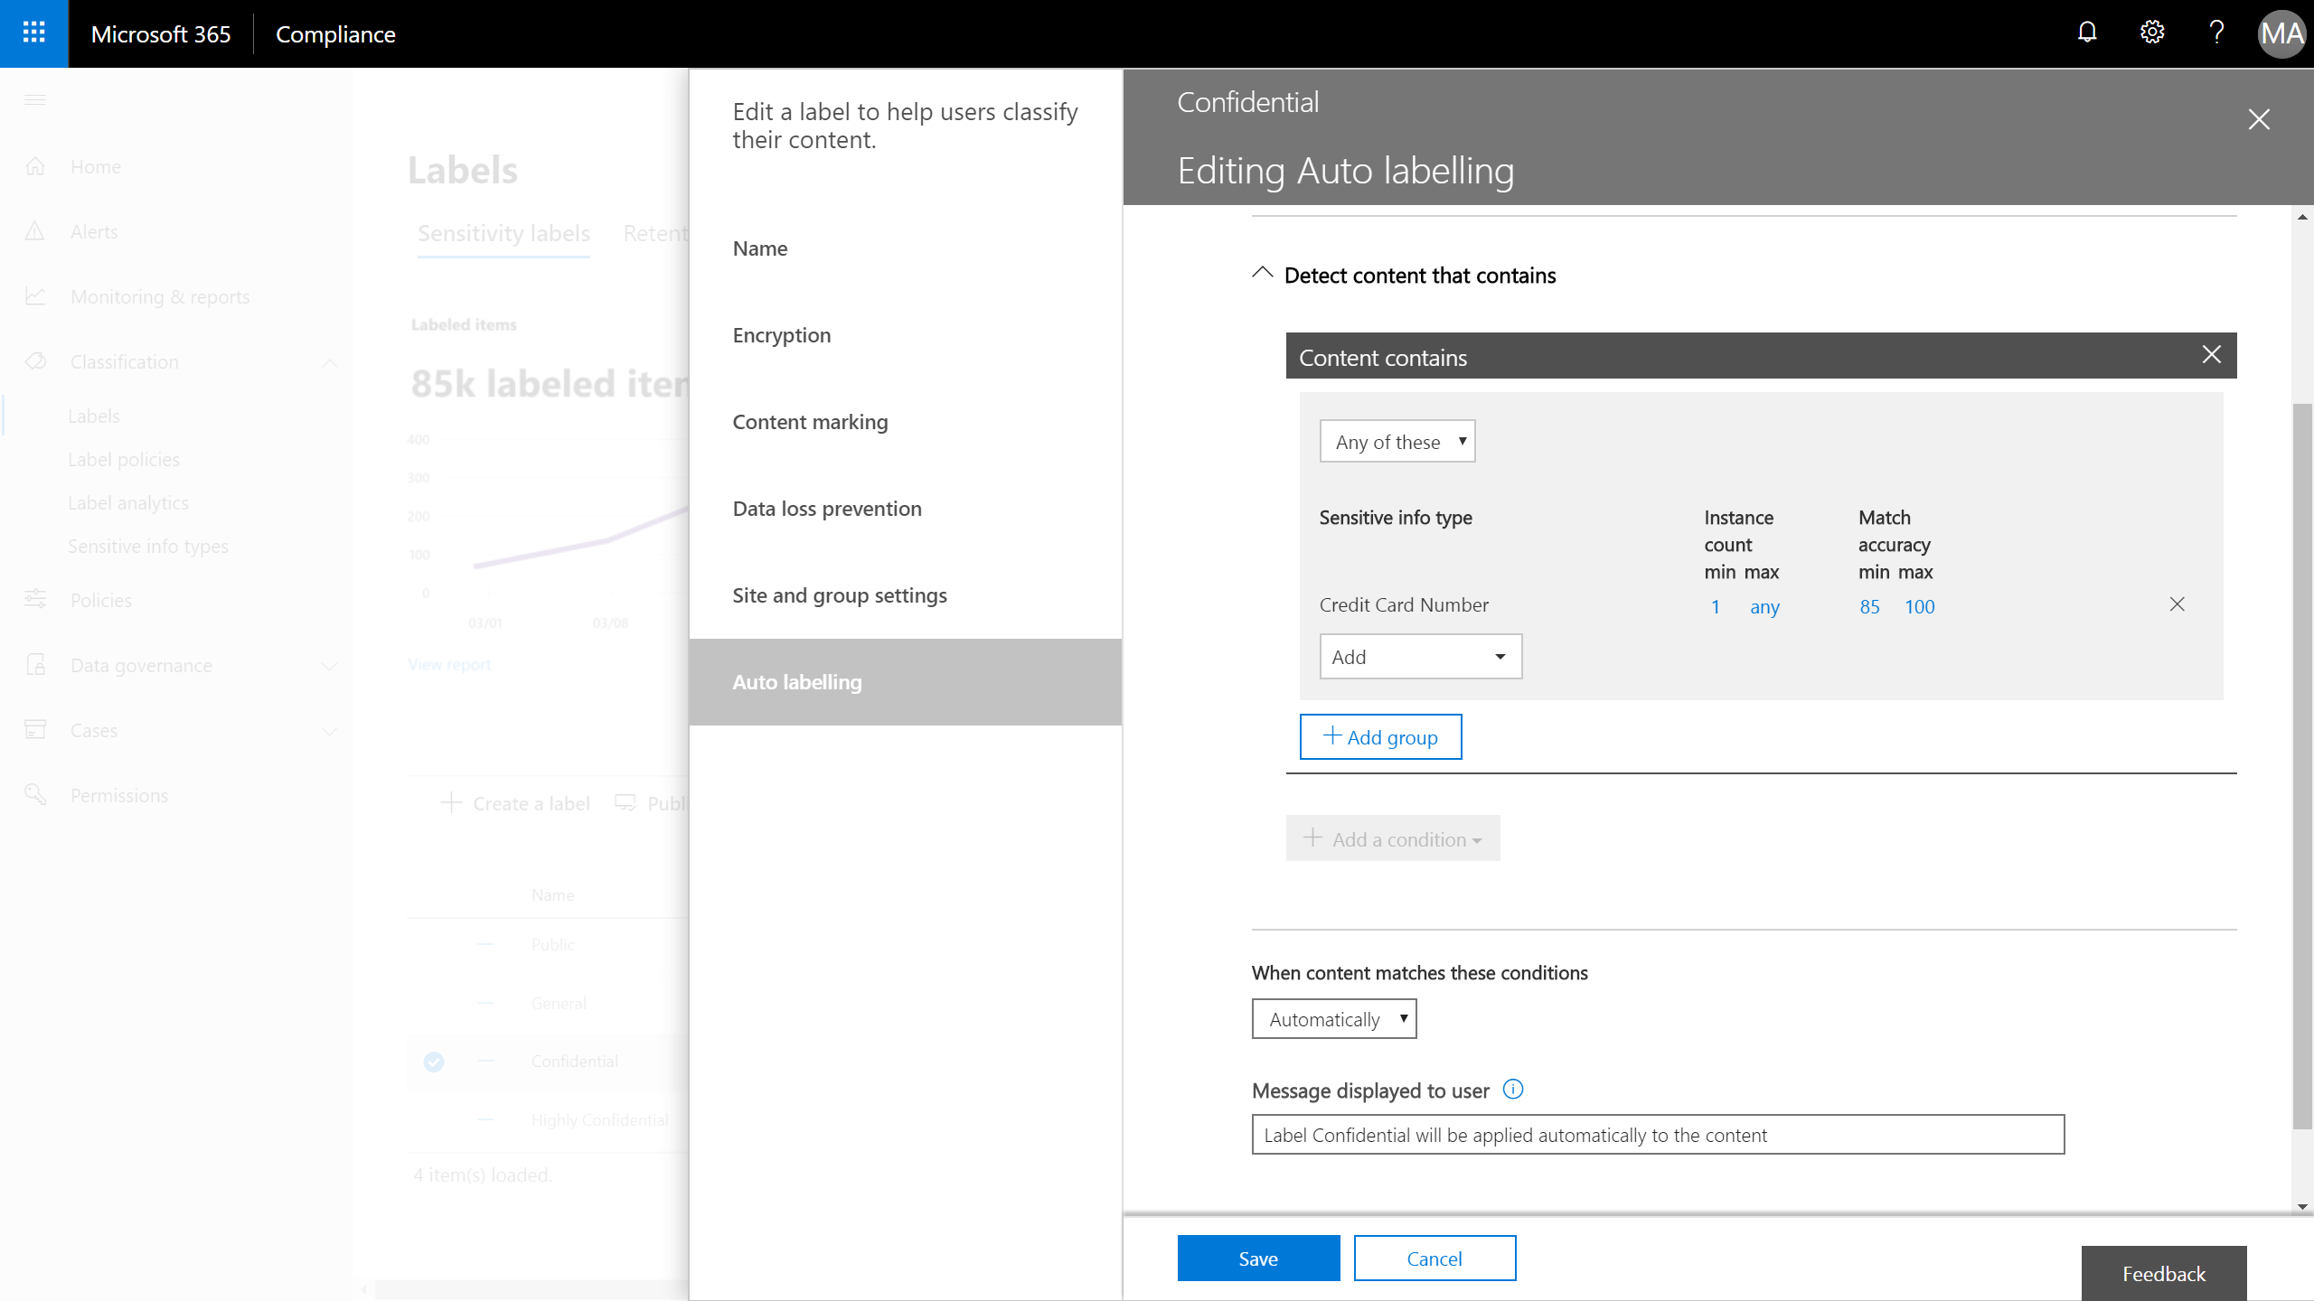

Slide 26
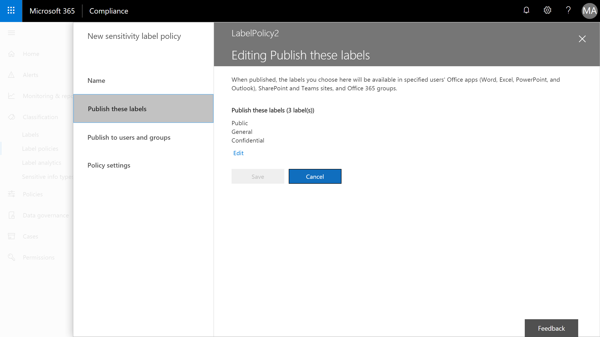

Slide 27
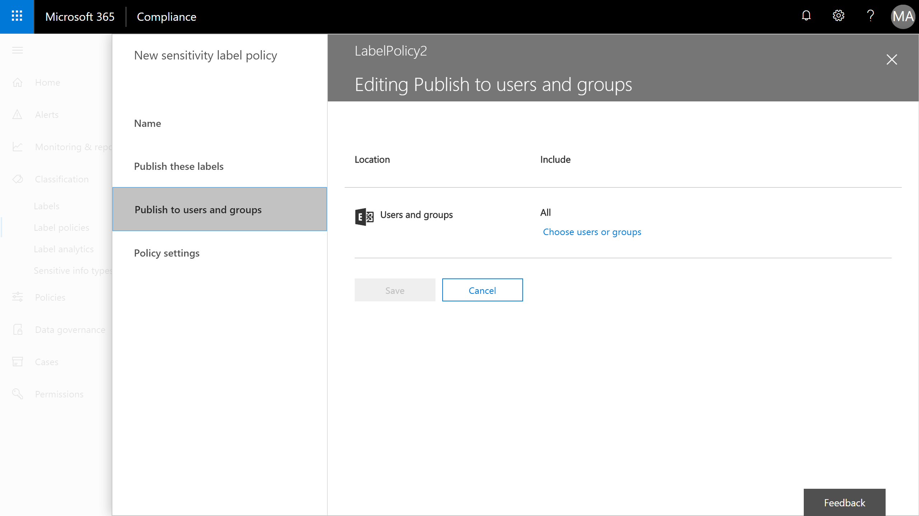

Slide 28
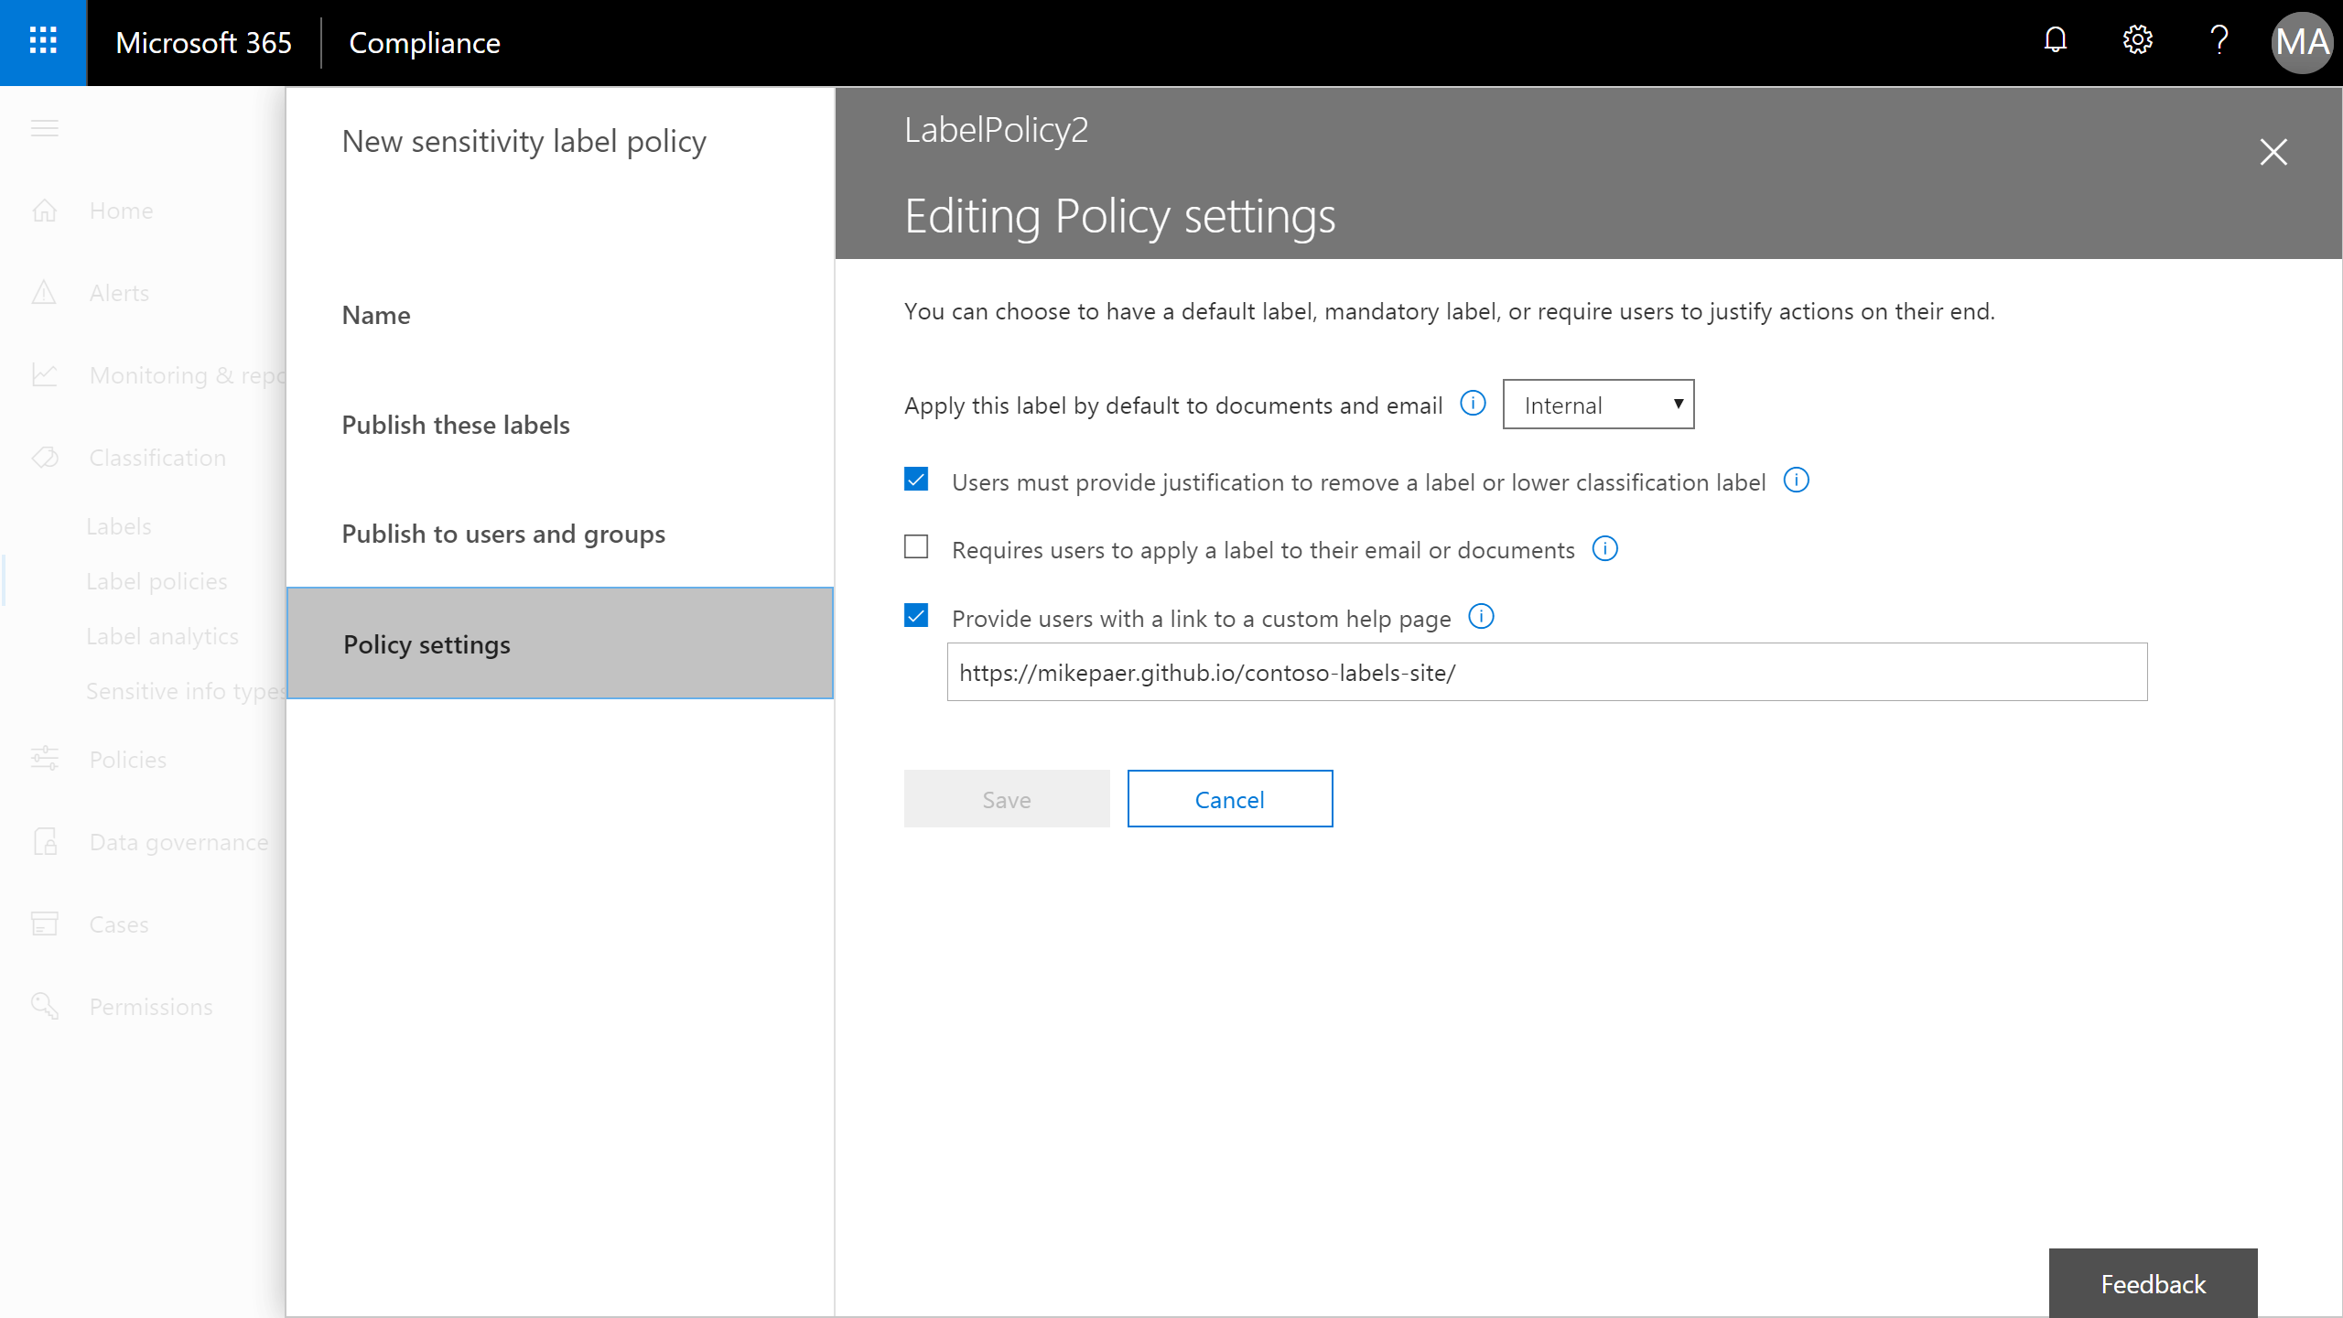

Slide 29
Demo
Retention Outcomes

Slide 30
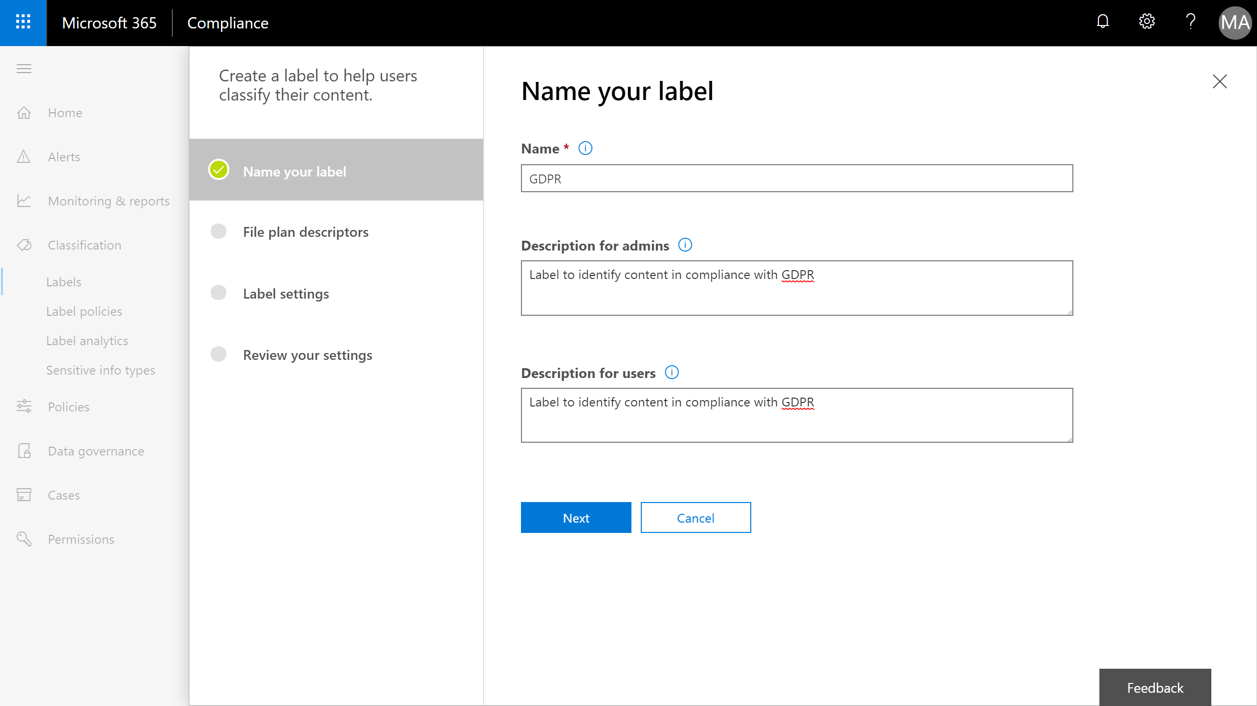
Available Now

Slide 31
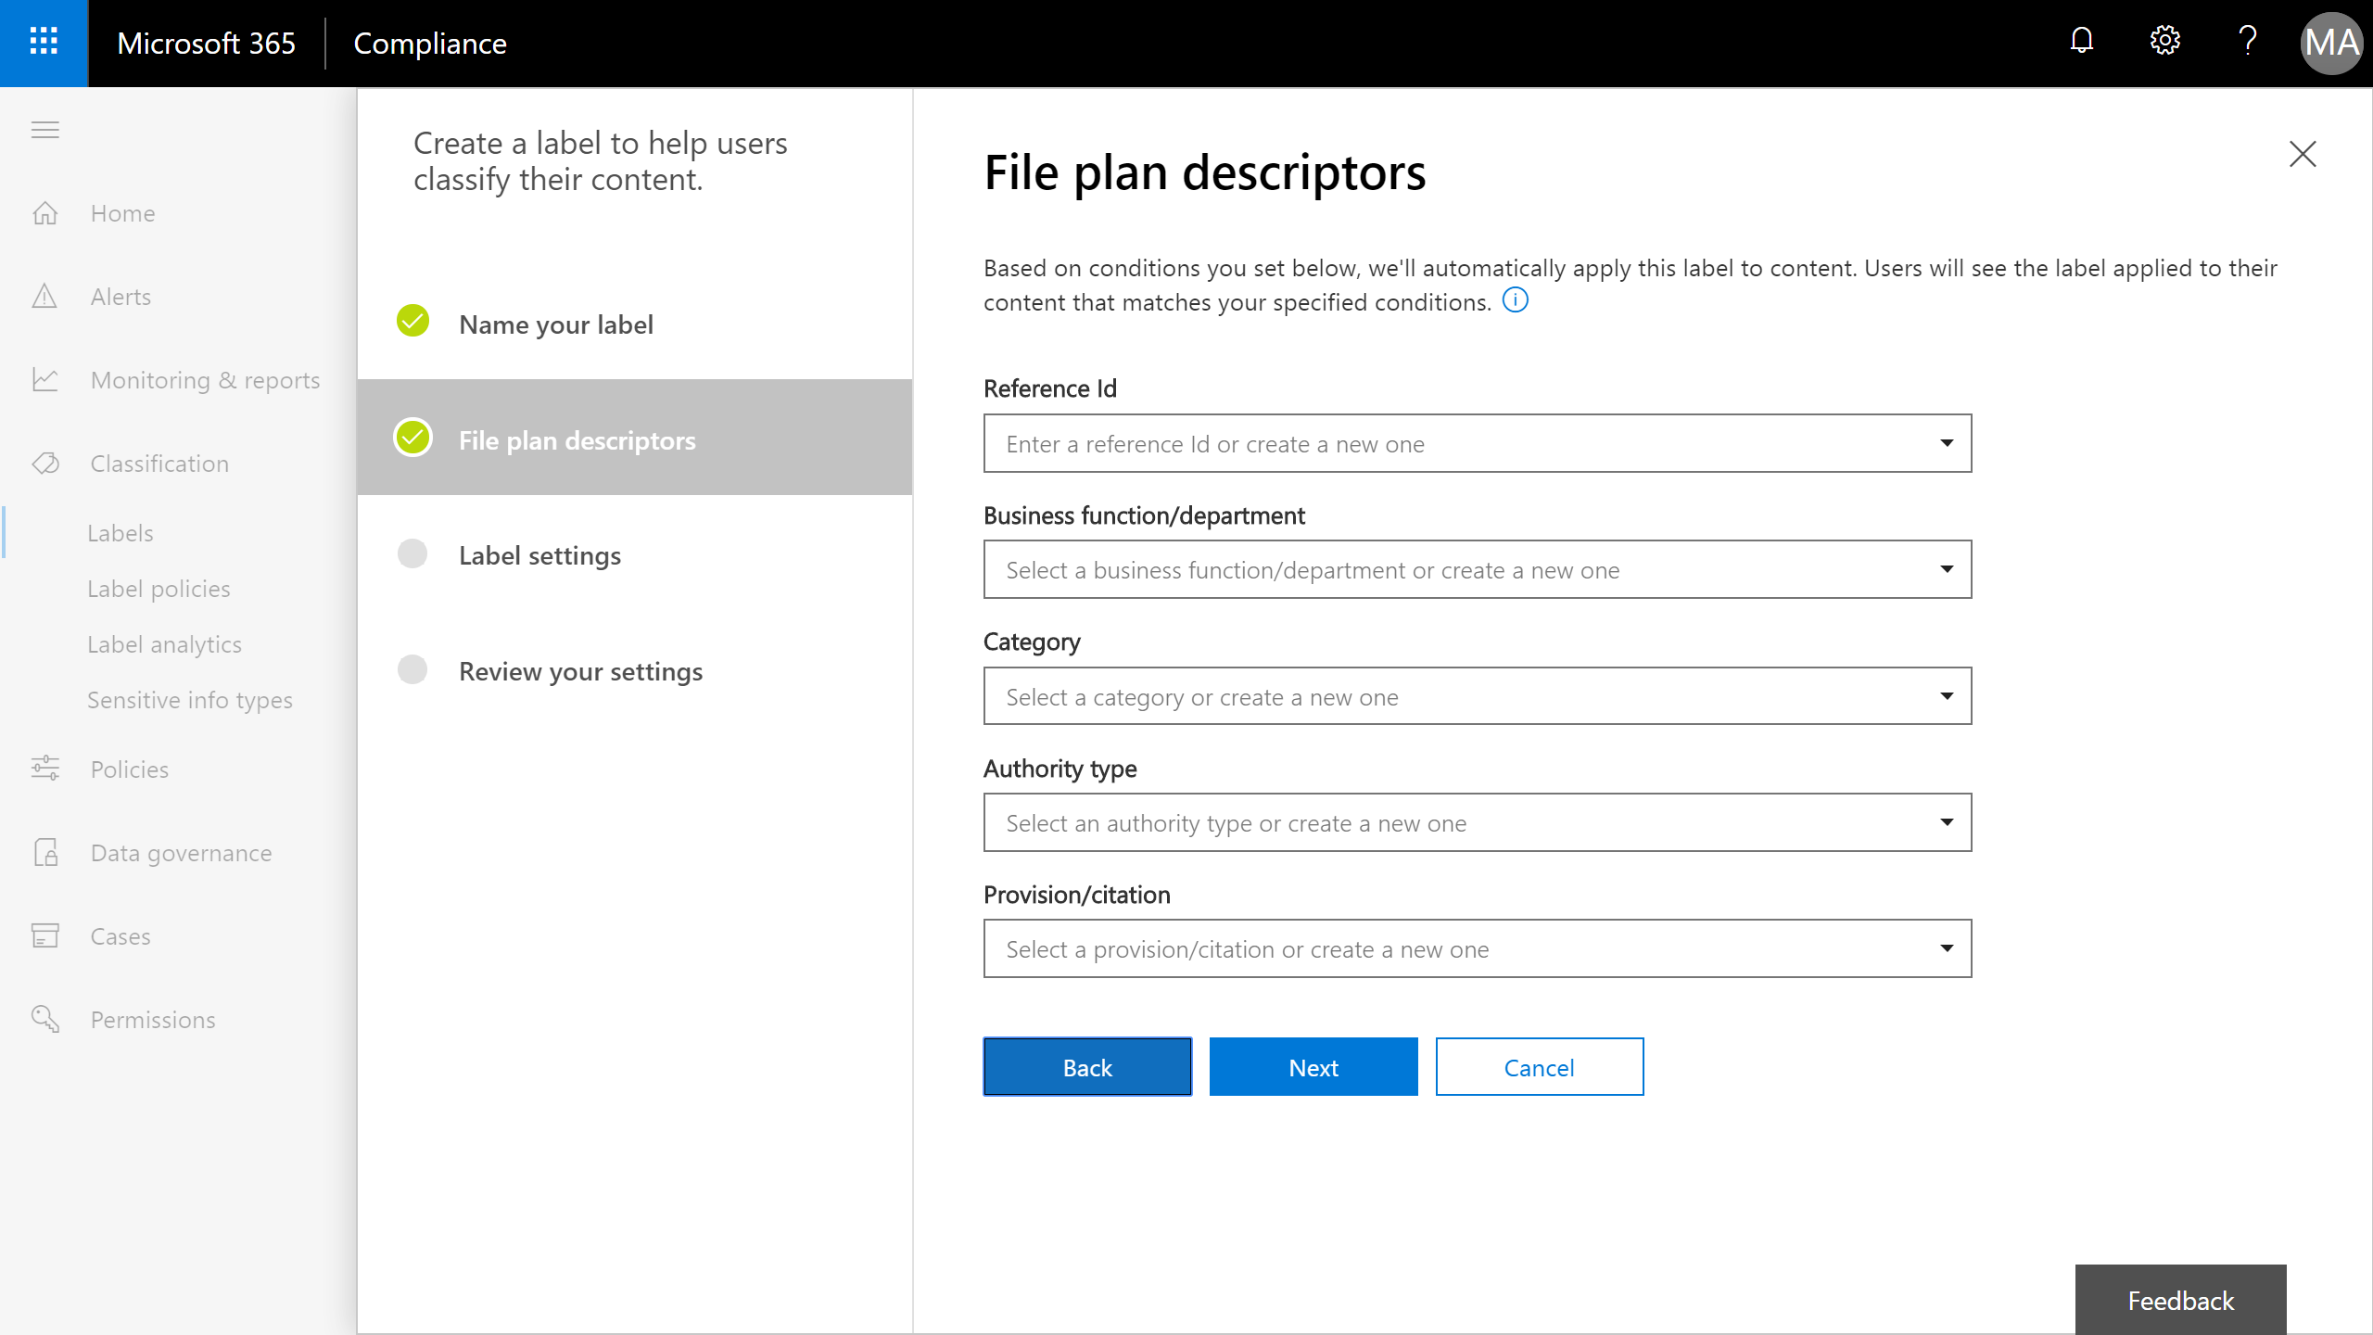

Slide 32
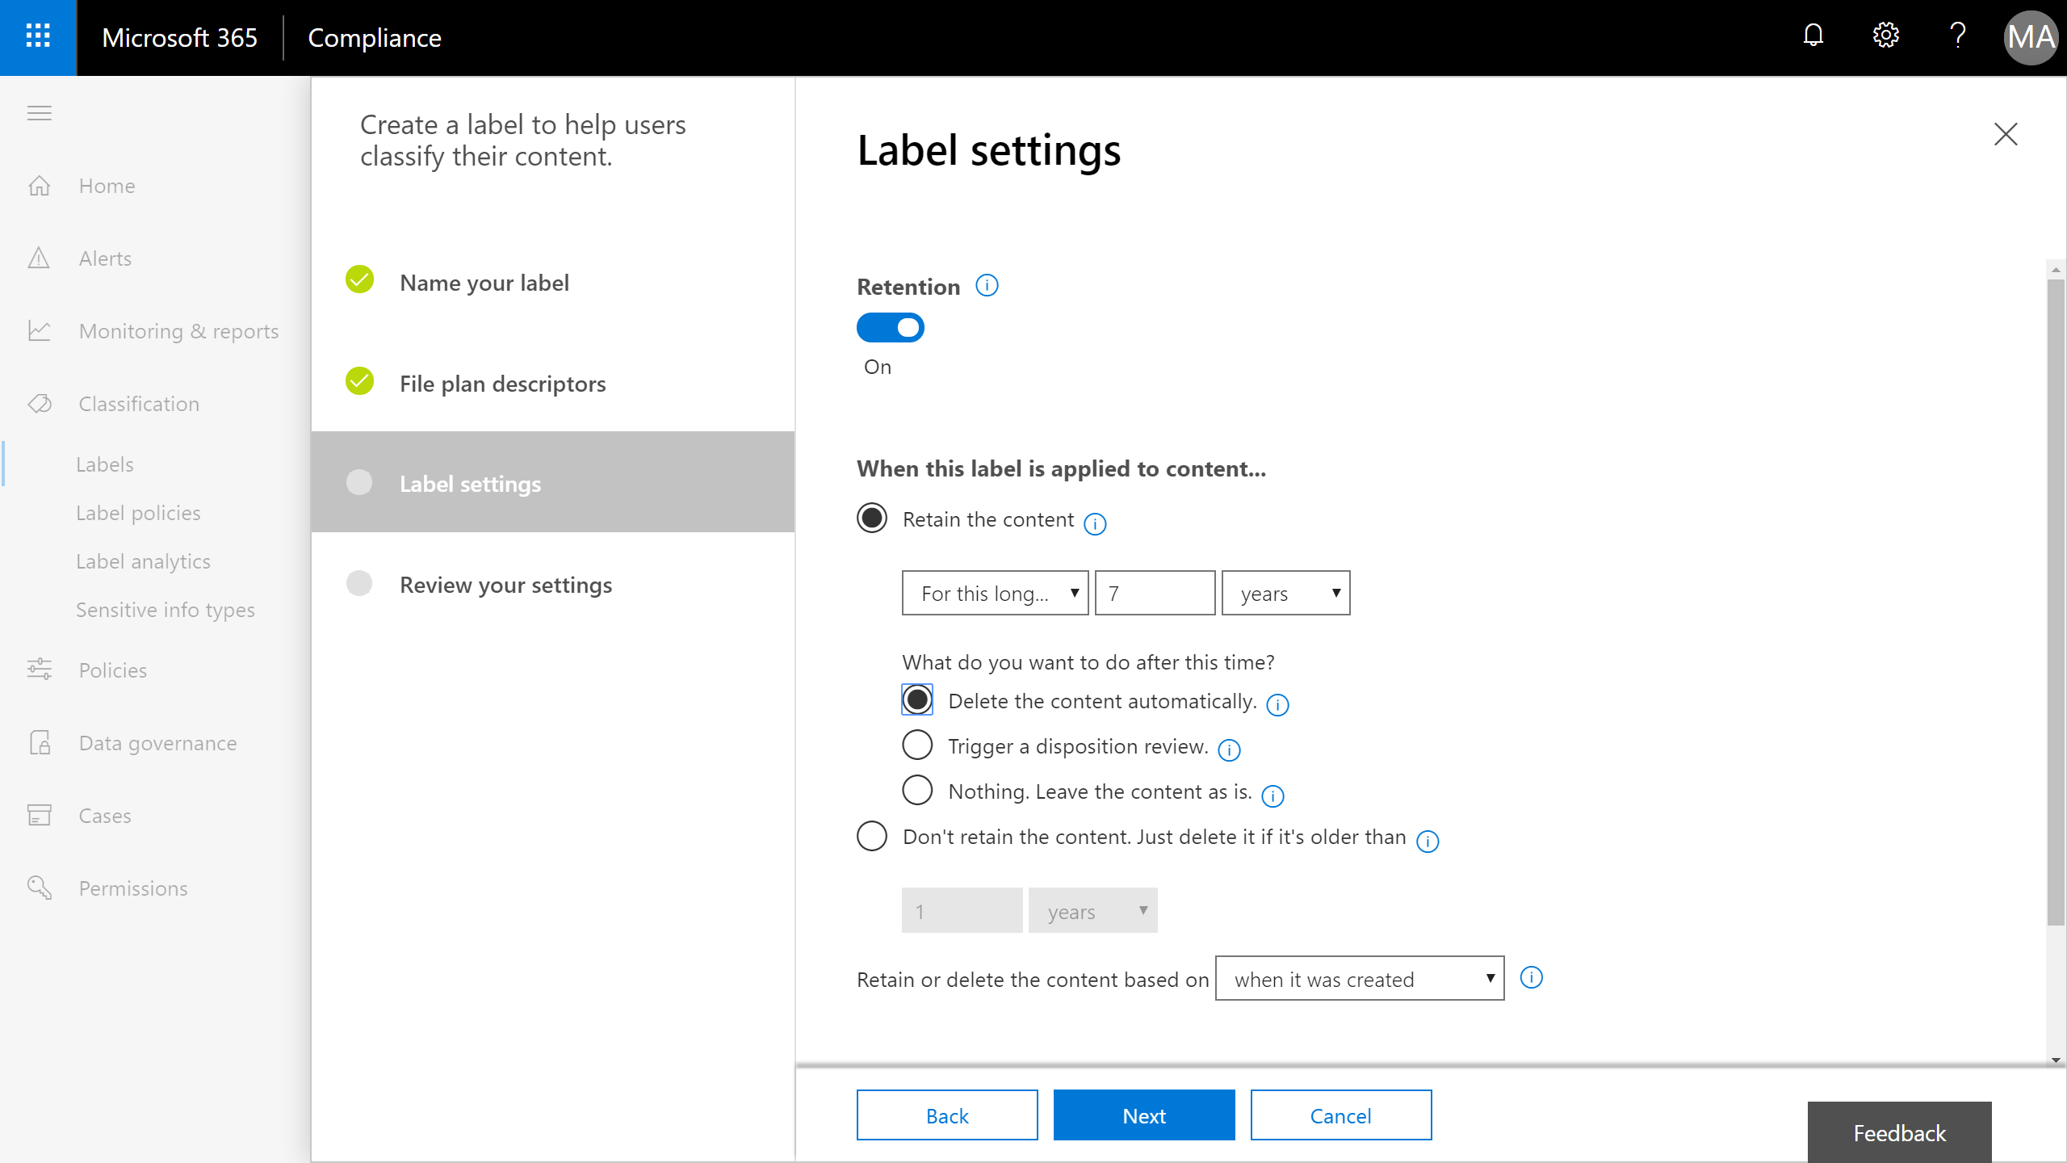

Slide 33
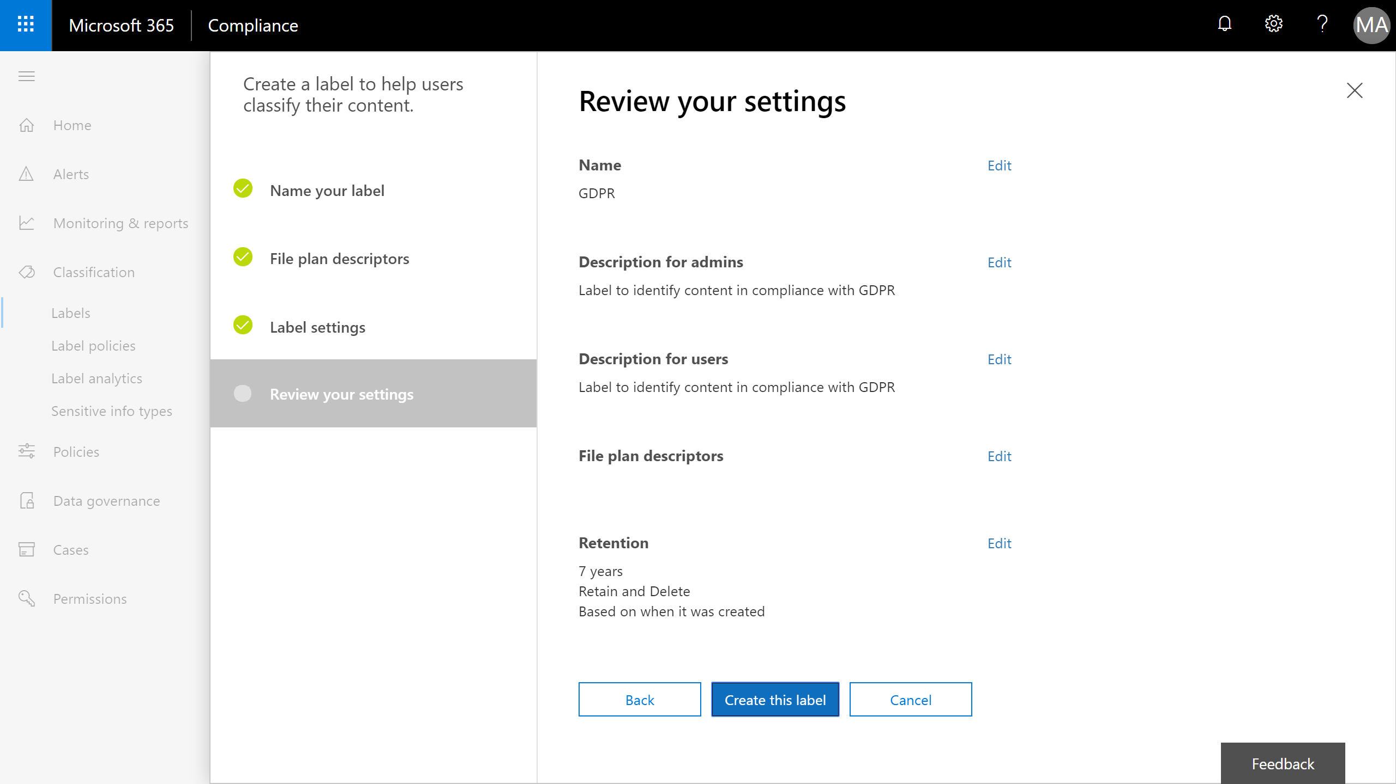

Slide 34
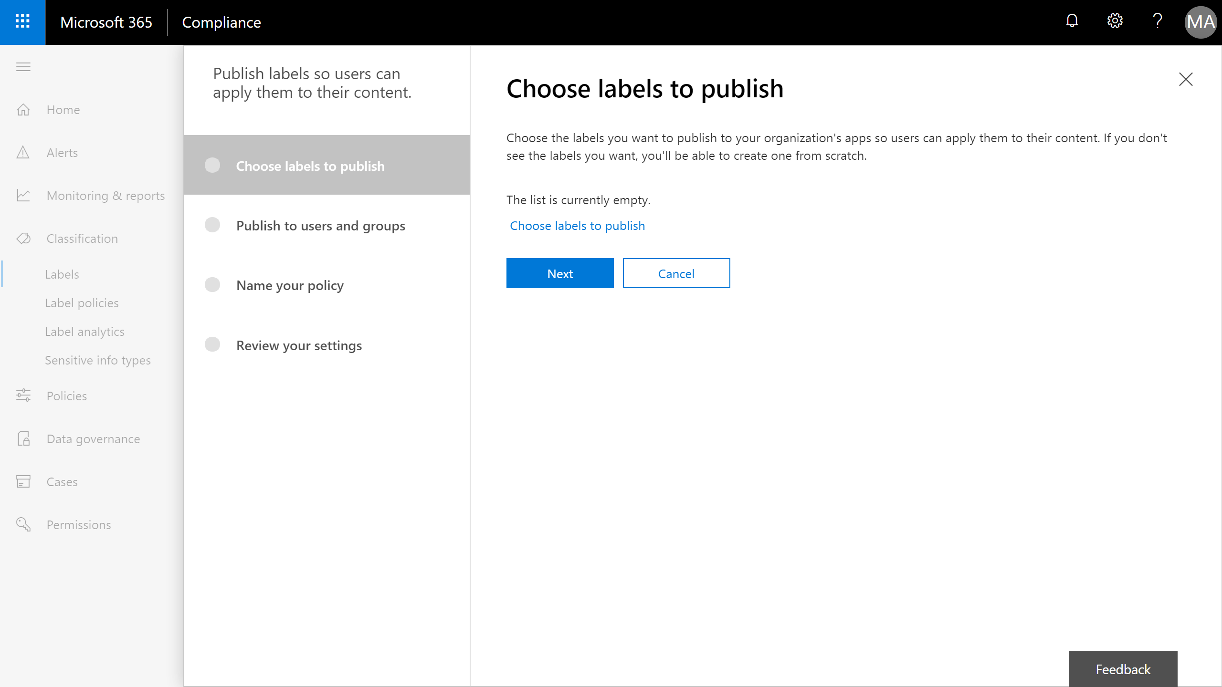

Slide 35
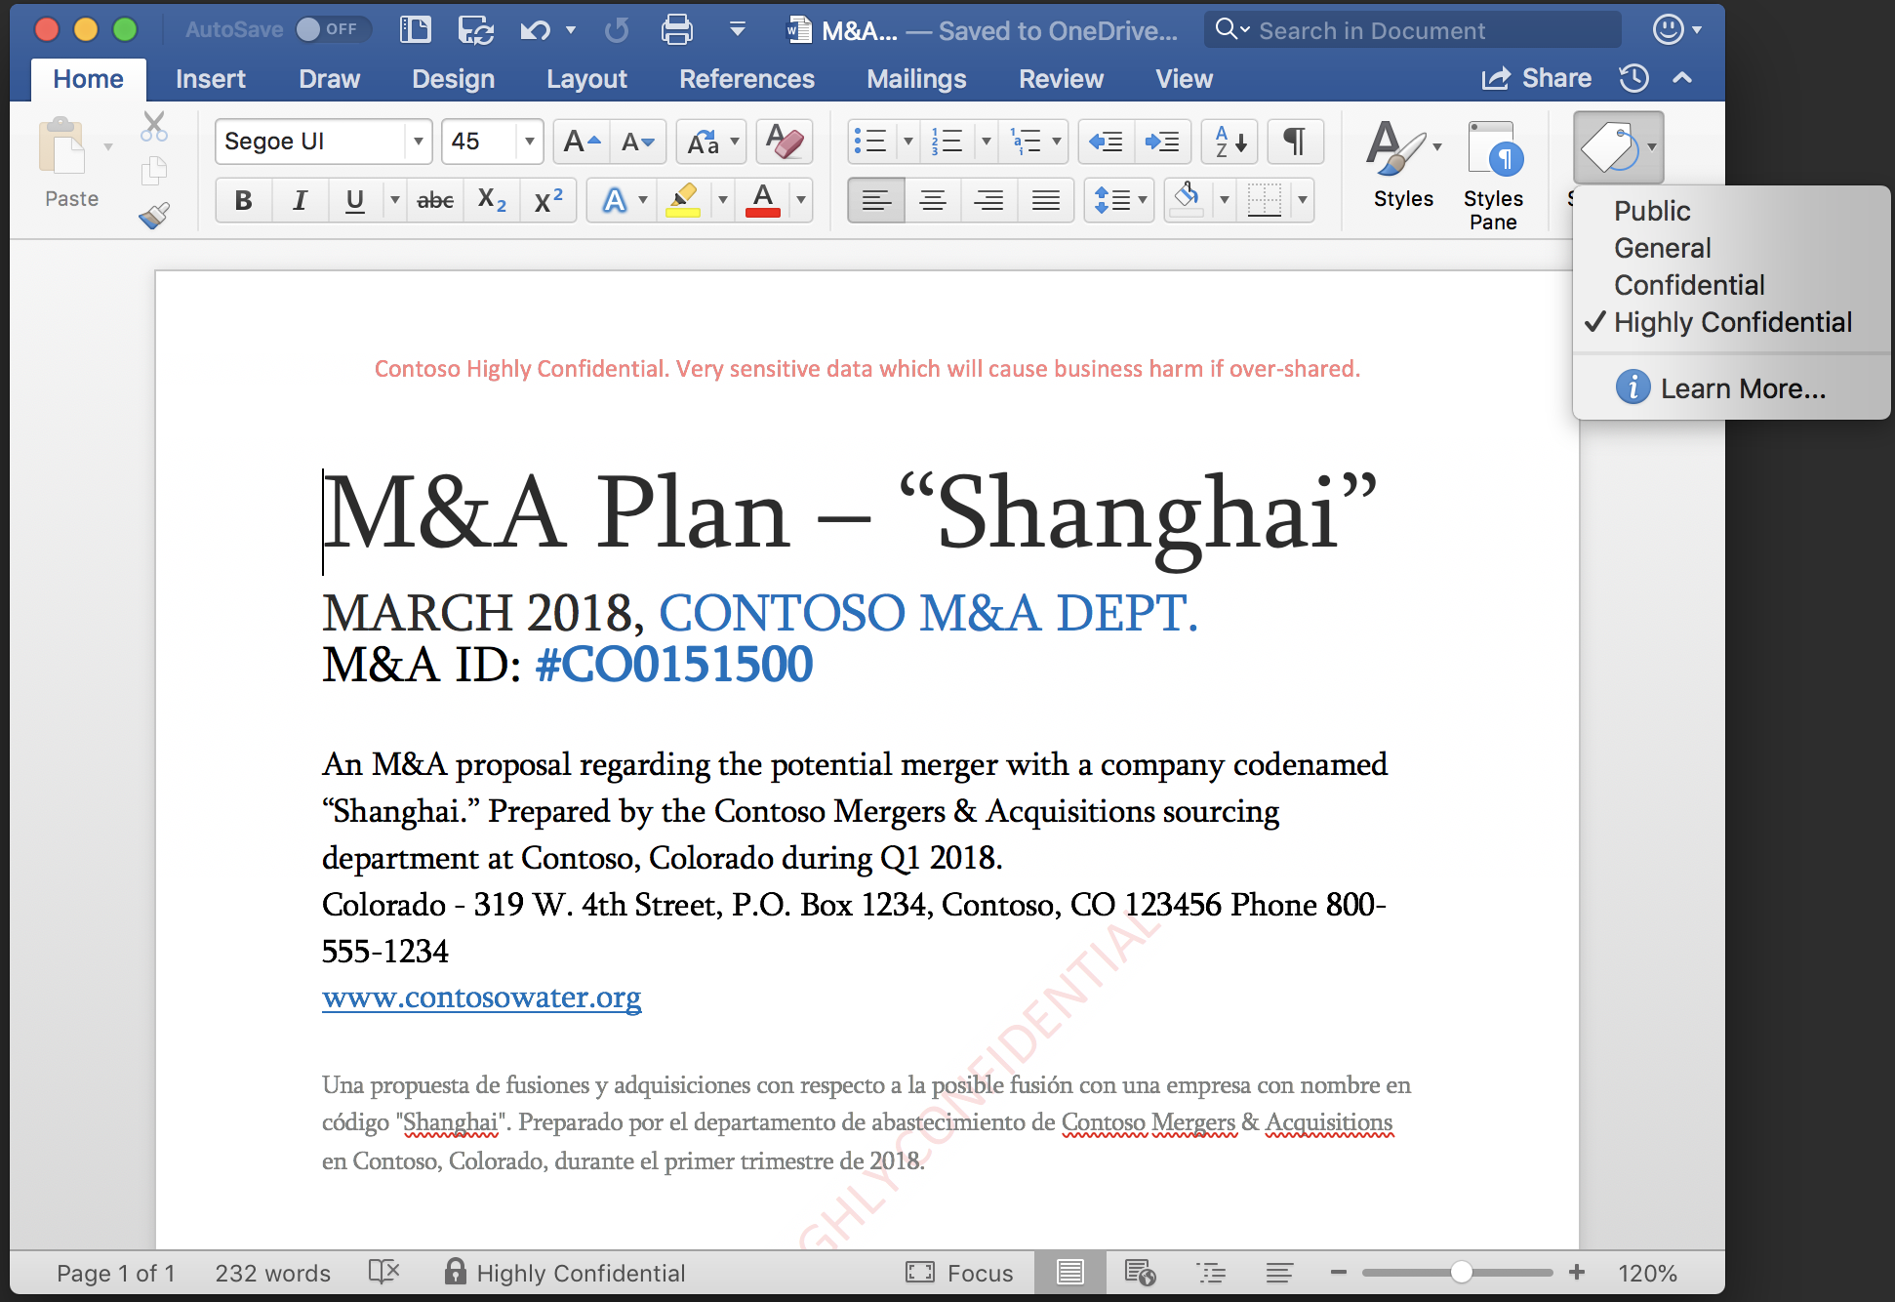
Native labeling experiences built into Office applications
Preview
Consistent and easy for users
Apply and update labels while working in Office apps – Word, PowerPoint, Excel and Outlook
Built-in
Integrated natively into Office apps; no plug-ins or add-ons required for latest Office 365 apps.
Broad platform support
Starting next week: Mac, iOS and Android public preview via Office Insider
Office on Windows and Outlook mobile public preview by EOY
AIP add-in available today

Slide 36
Demo
Office apps on Mac working with native sensitivity labeling

Slide 38
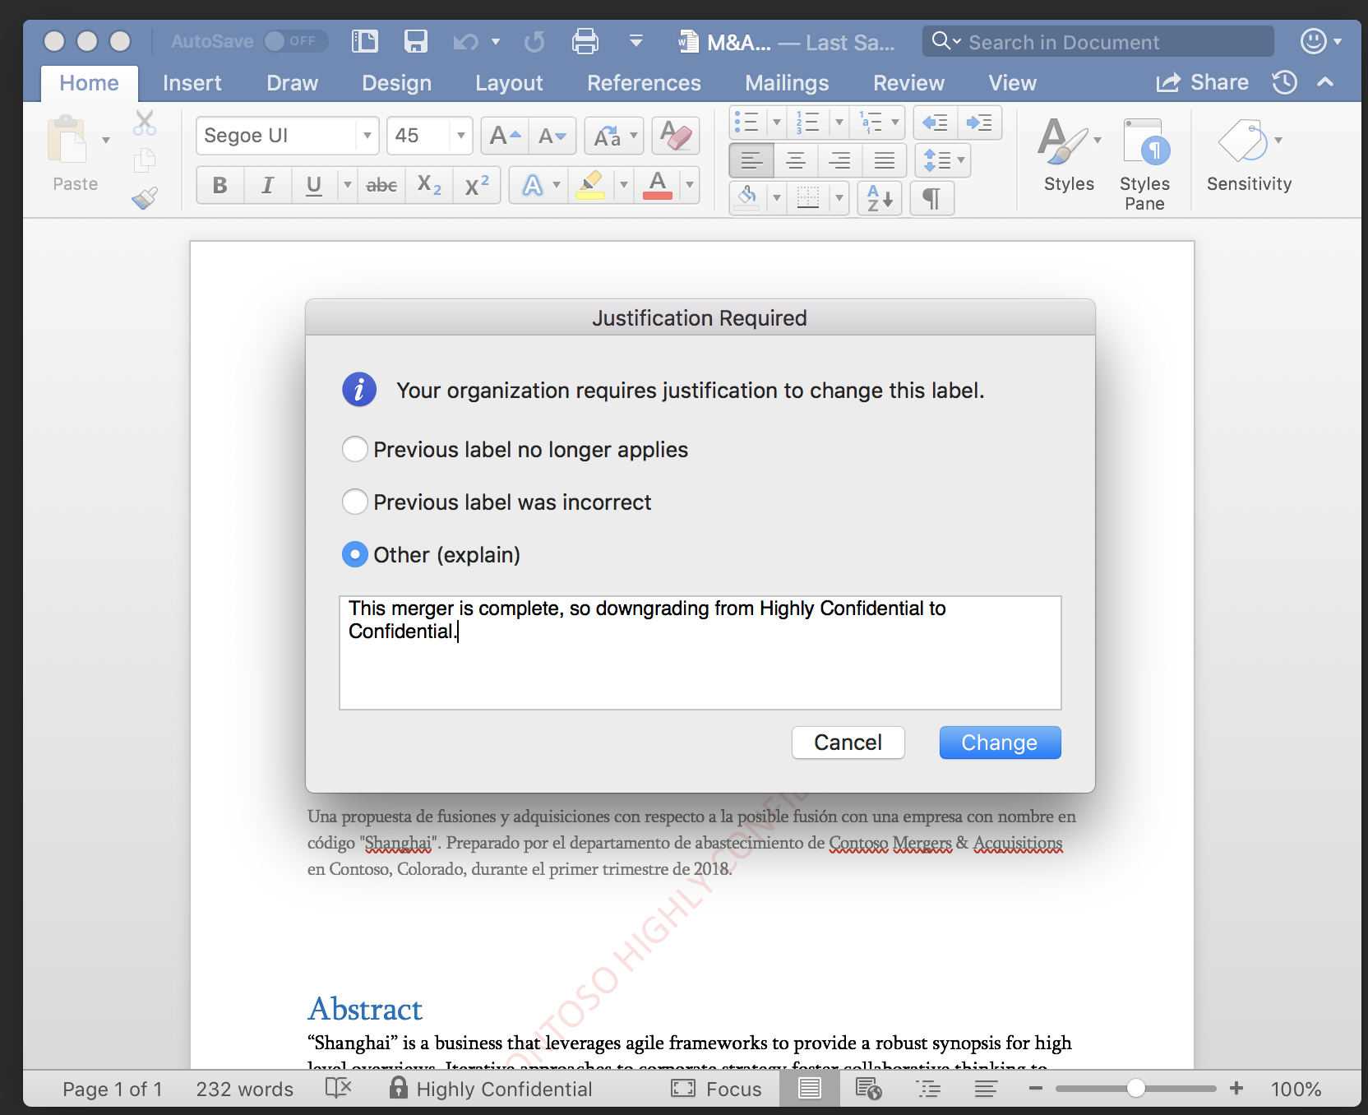

Slide 39
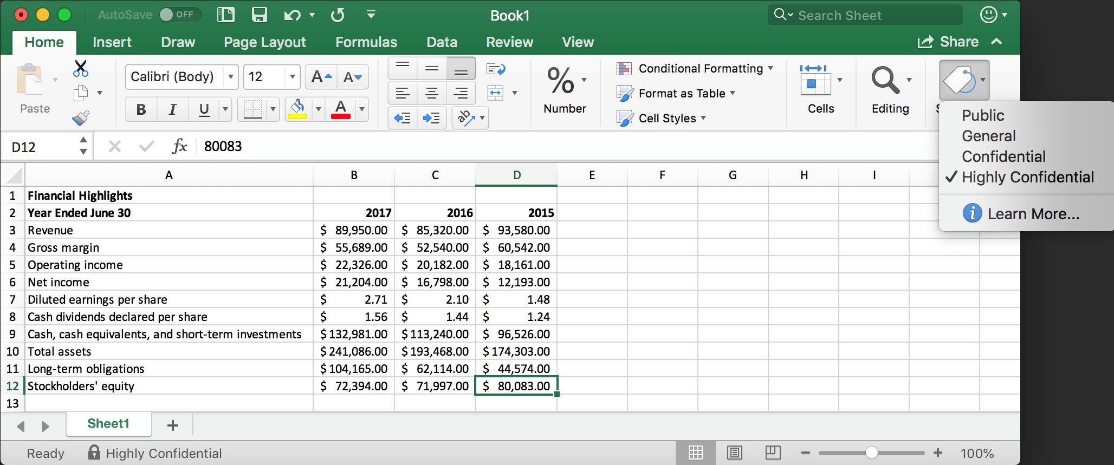

Slide 40
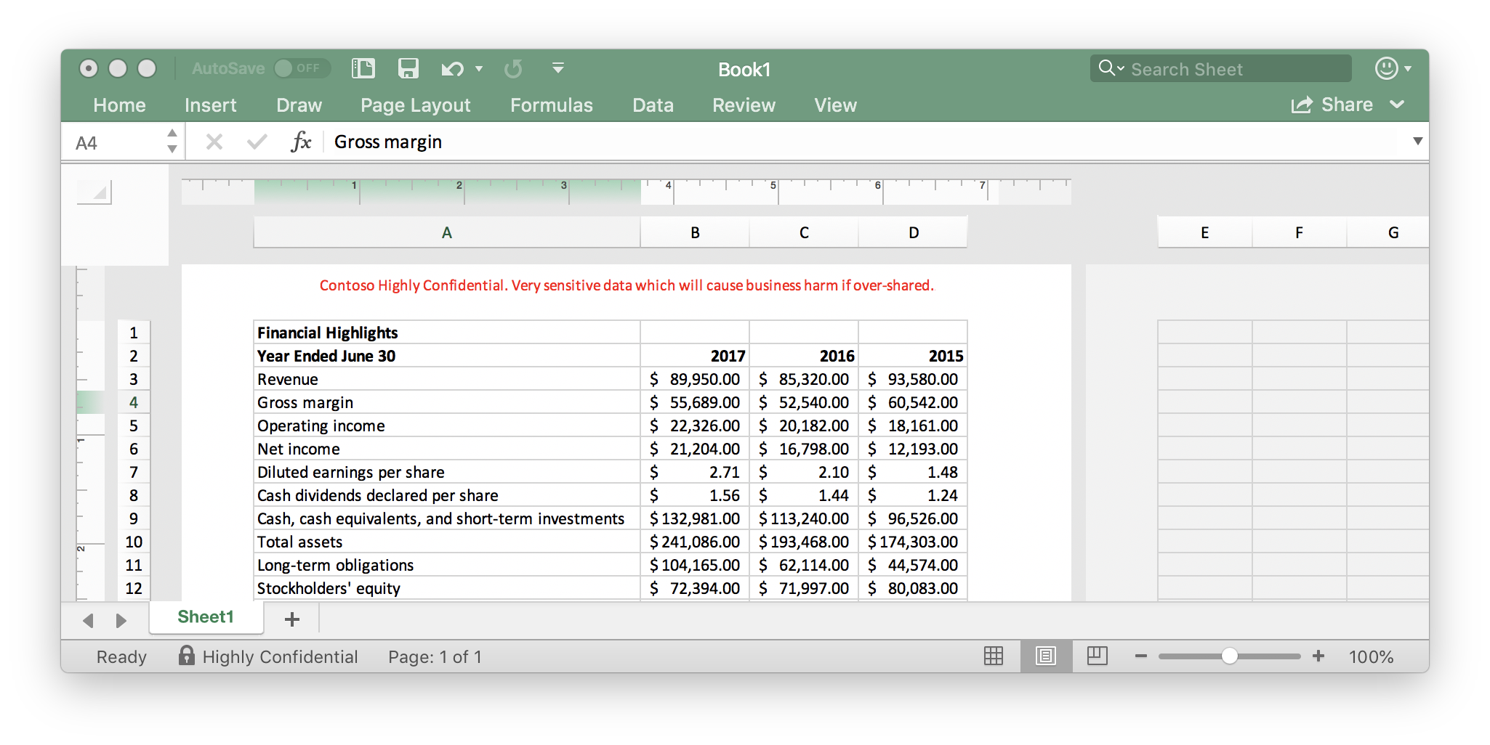

Slide 41
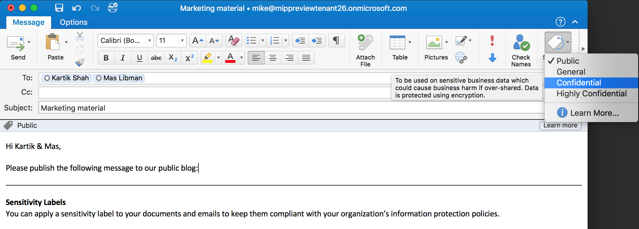

Slide 42
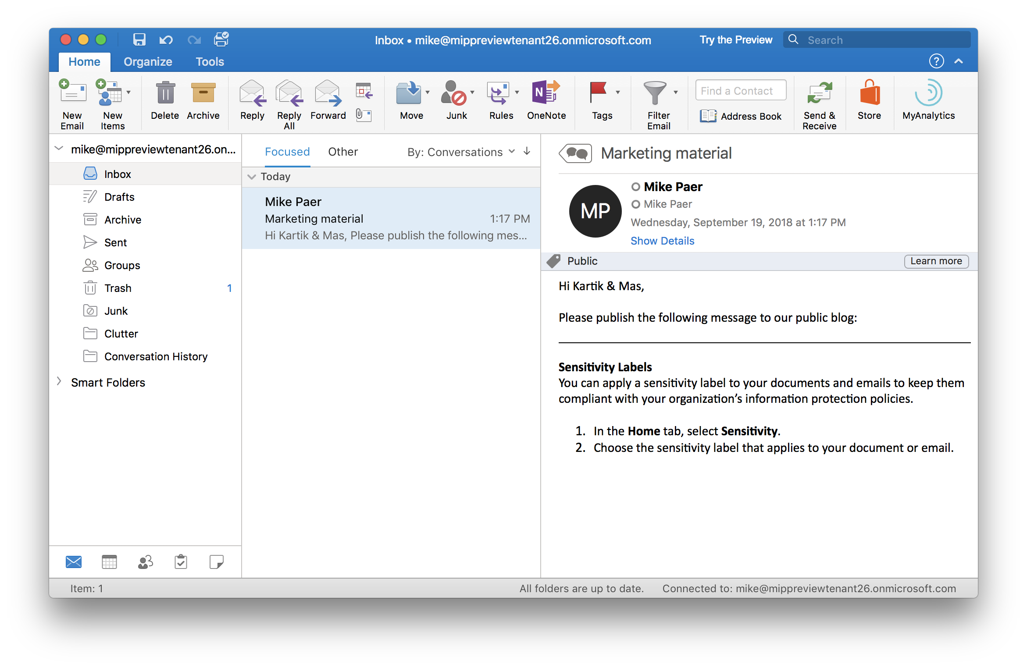

Slide 43
Demo
iOS Office

Slide 44
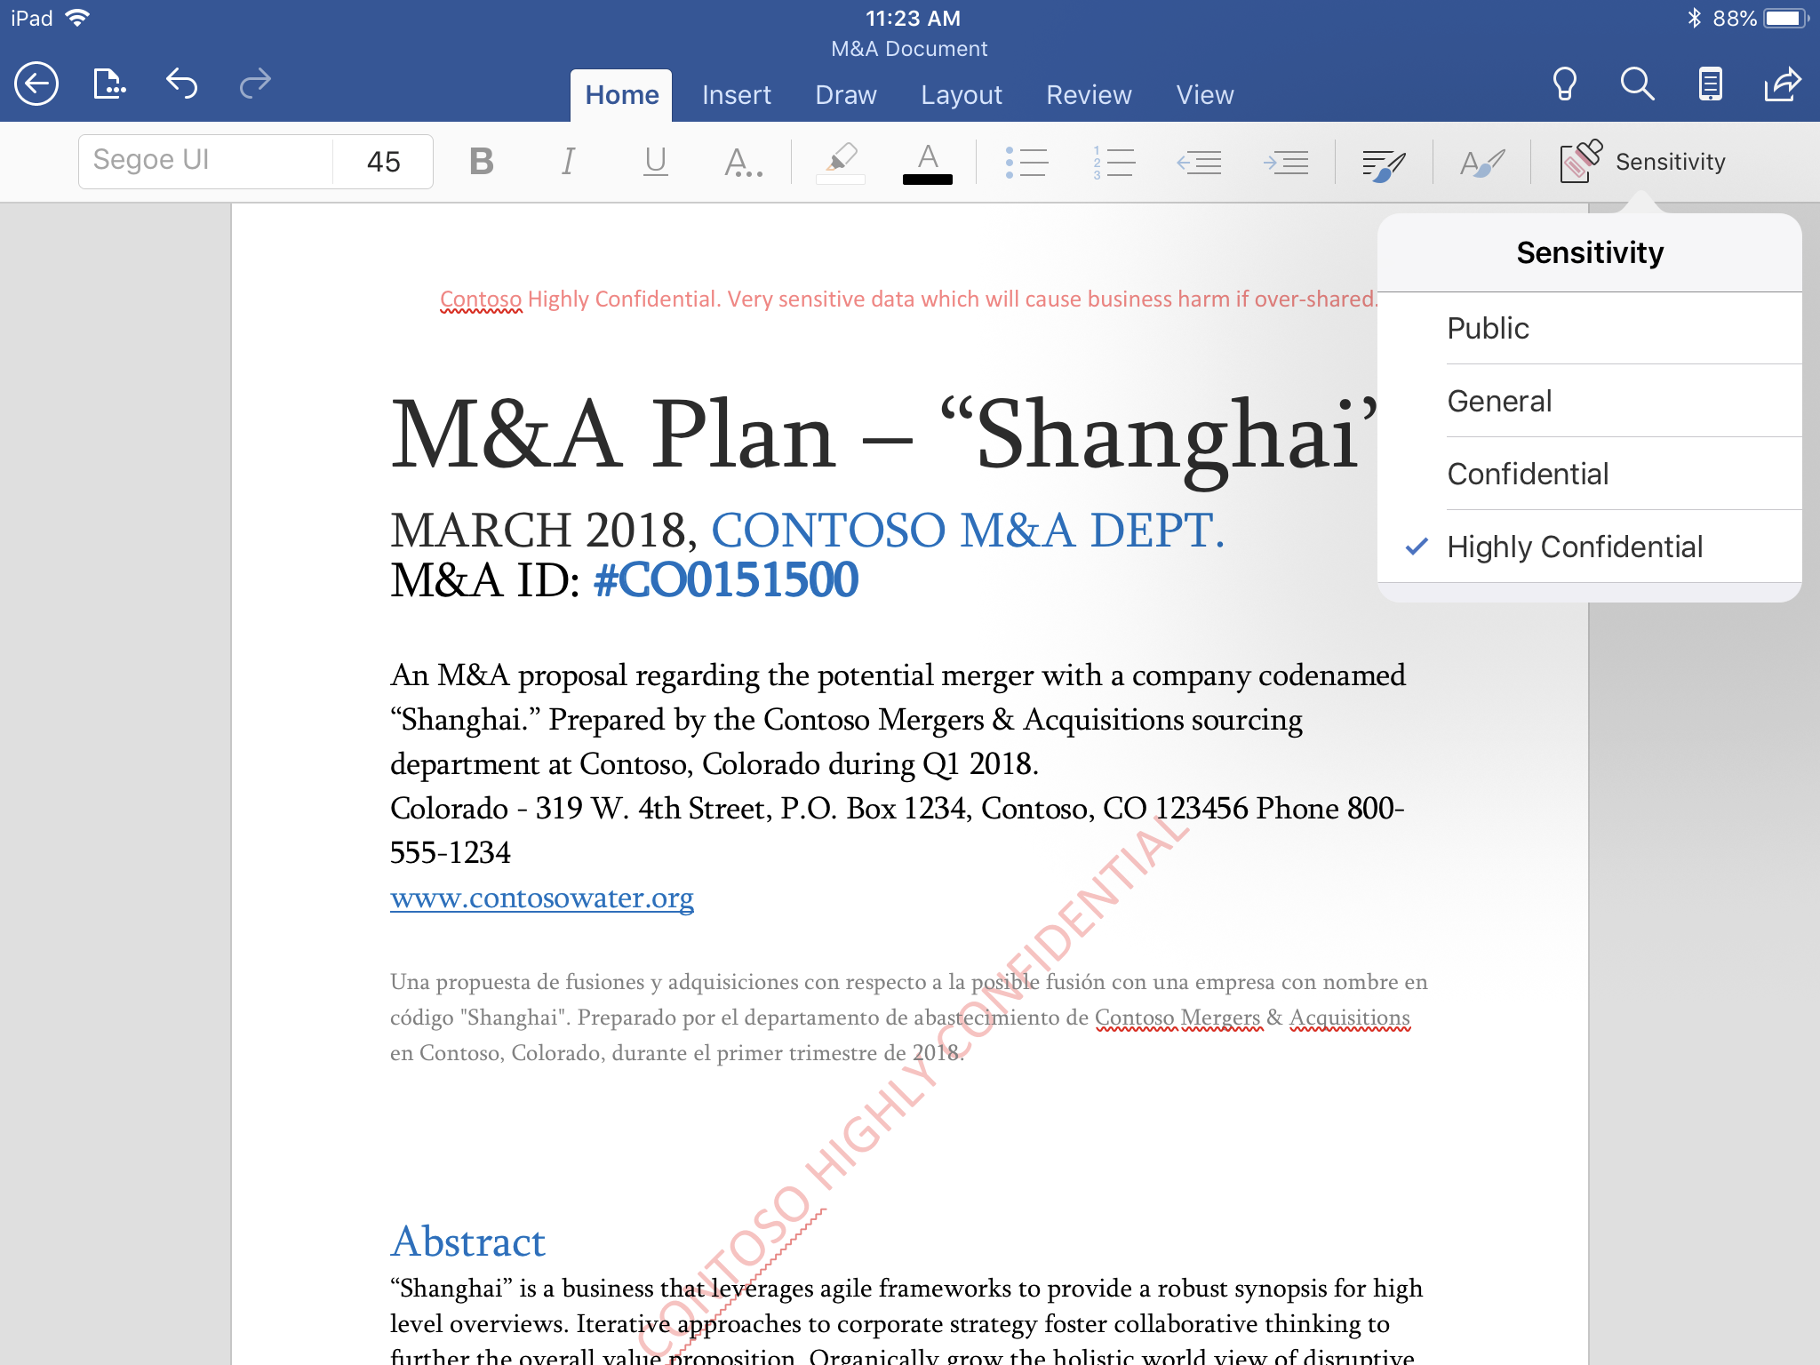

Slide 45
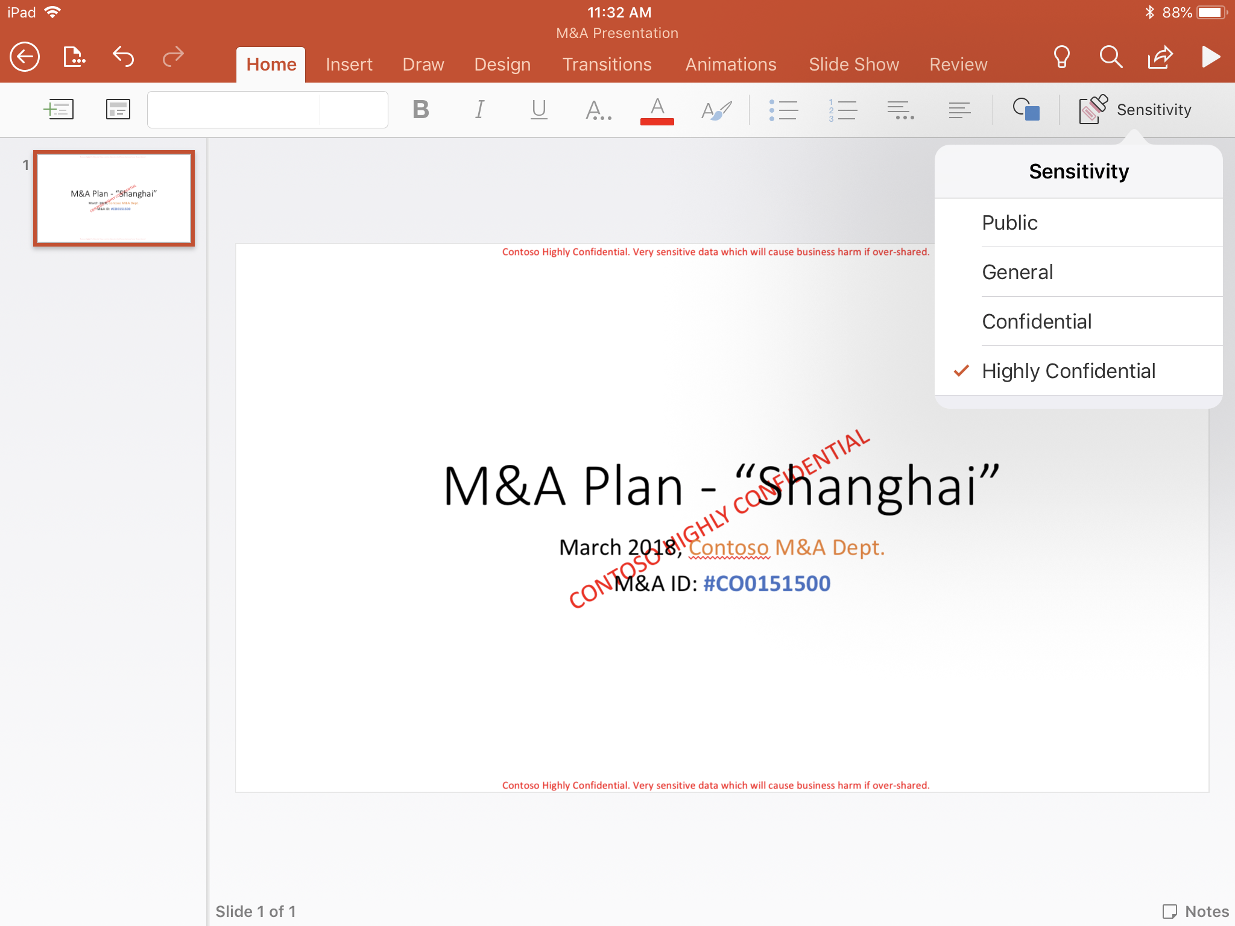

Slide 46
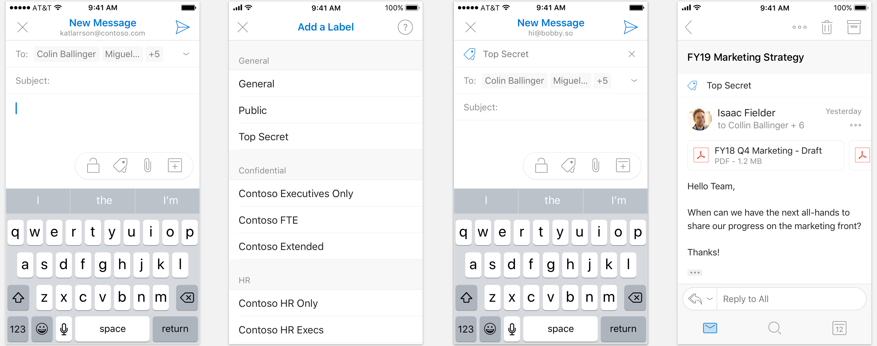
Preview – Dec’18

Slide 47
Demo
Android Office

Slide 48
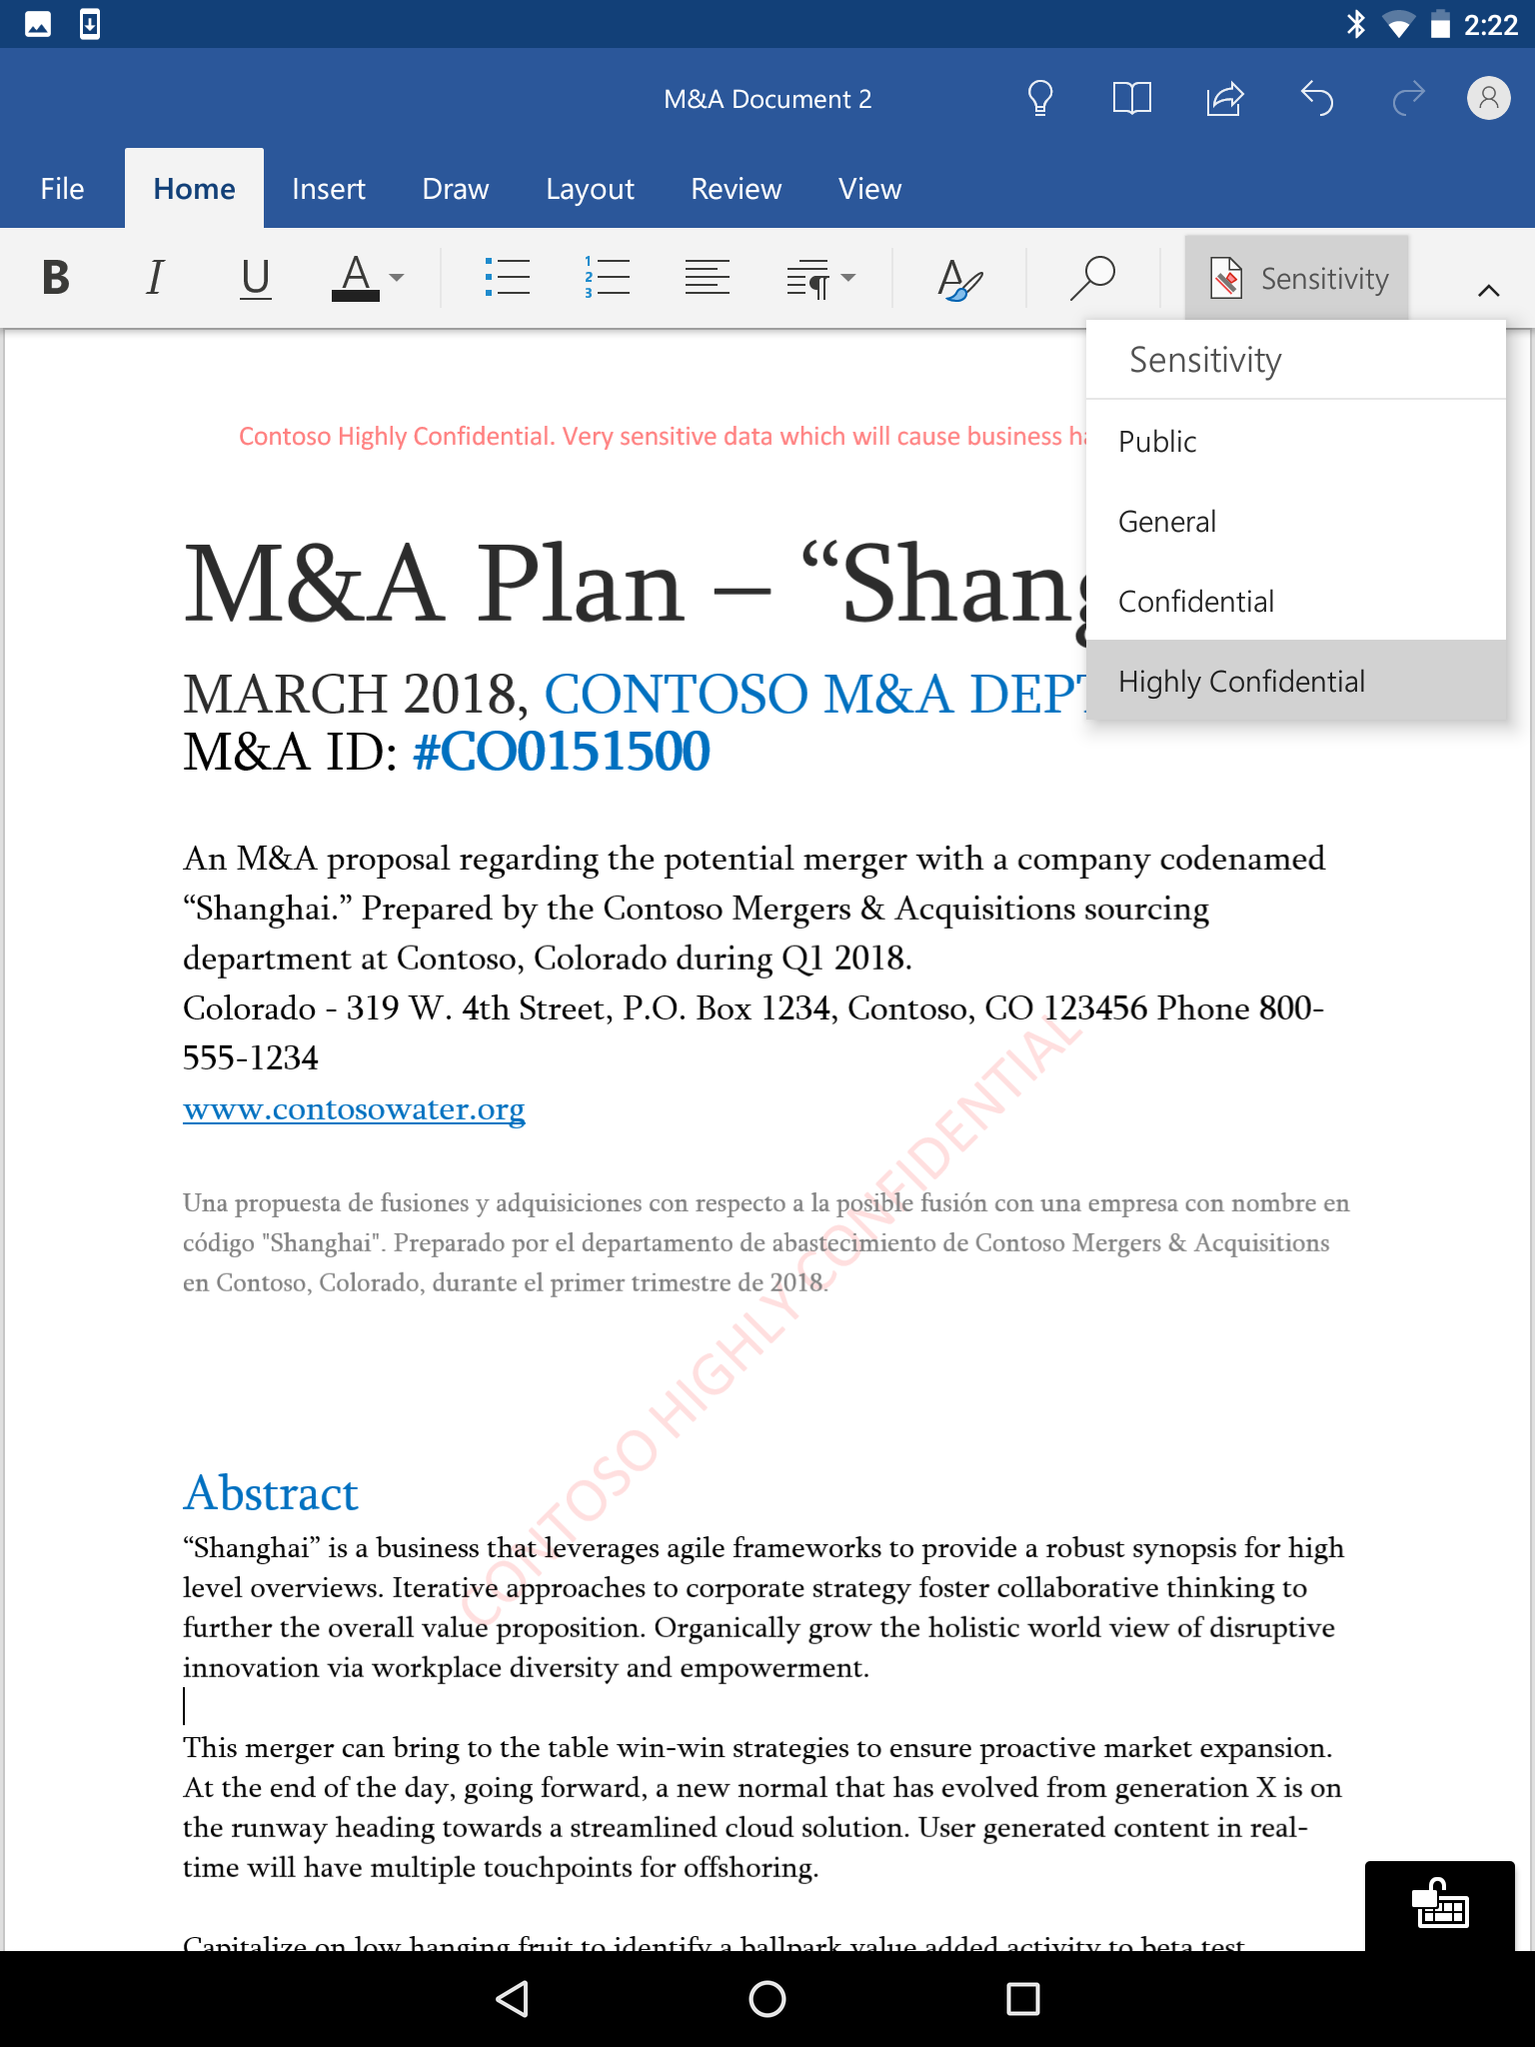

Slide 49
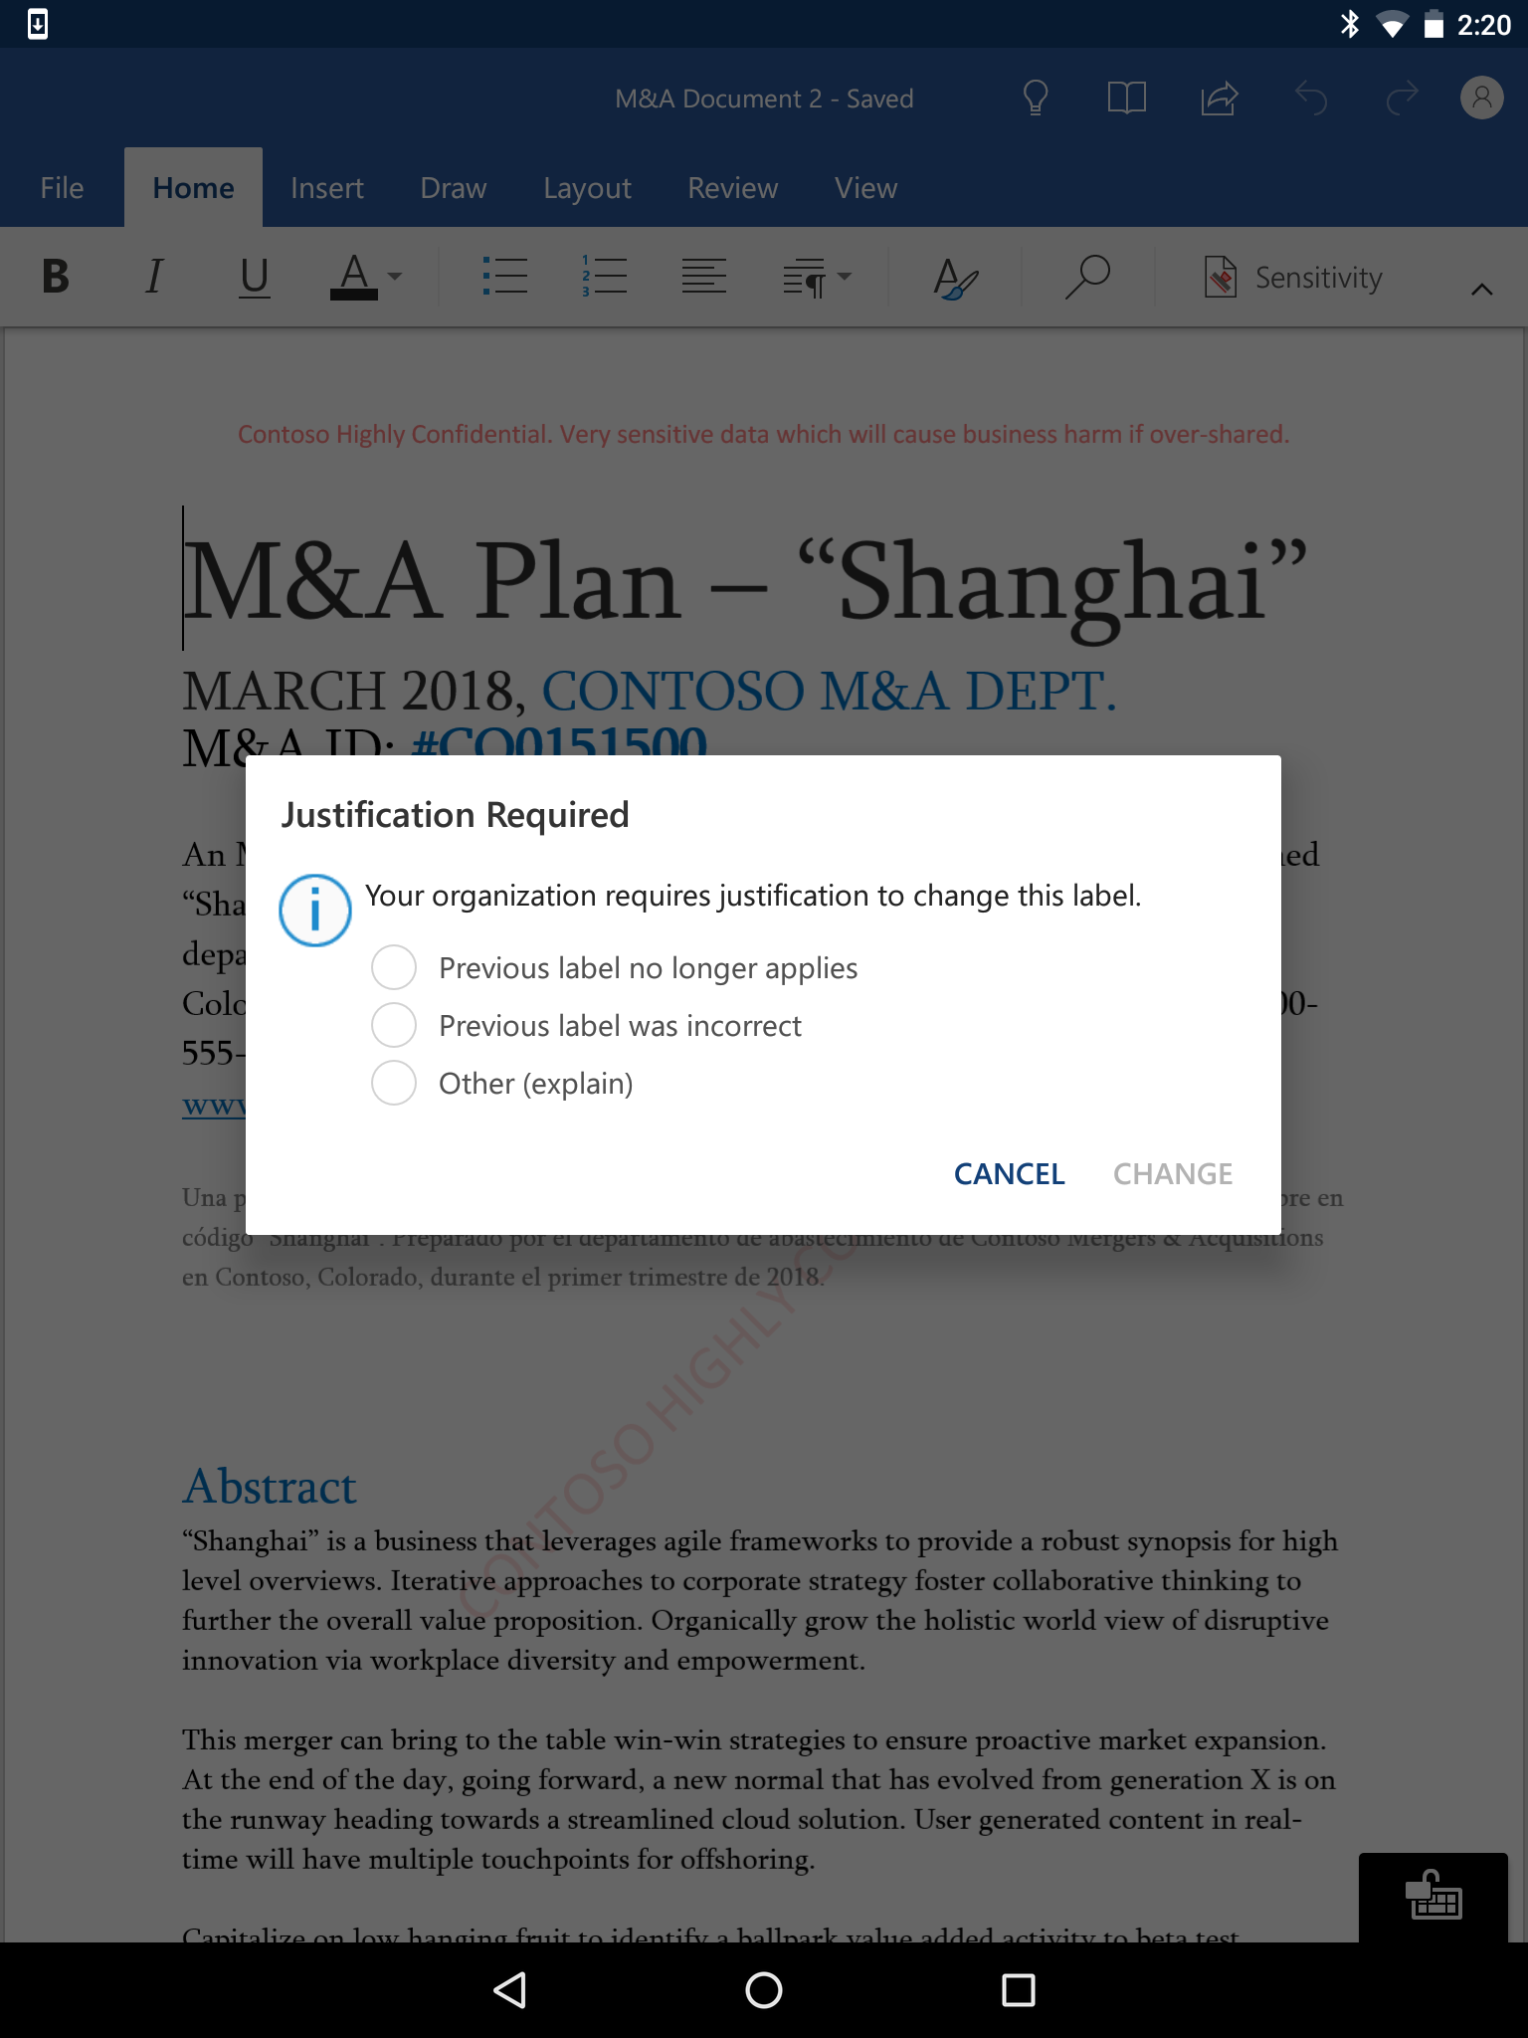

Slide 50
Demo
Office on Windows using AIP add-in

Slide 51
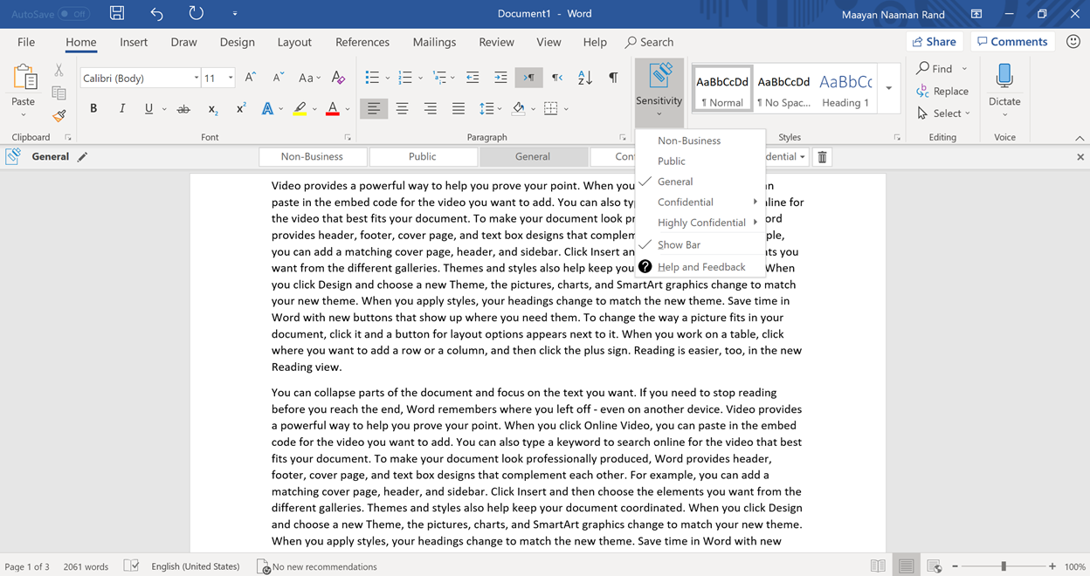

Slide 52
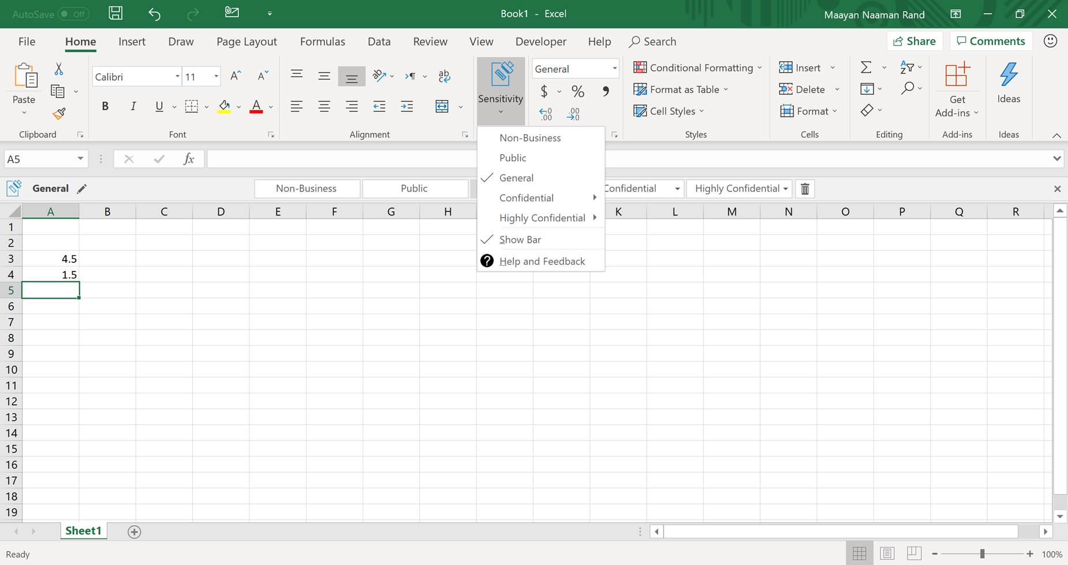

Slide 53
Demo
SPO with sensitive labels

Slide 54
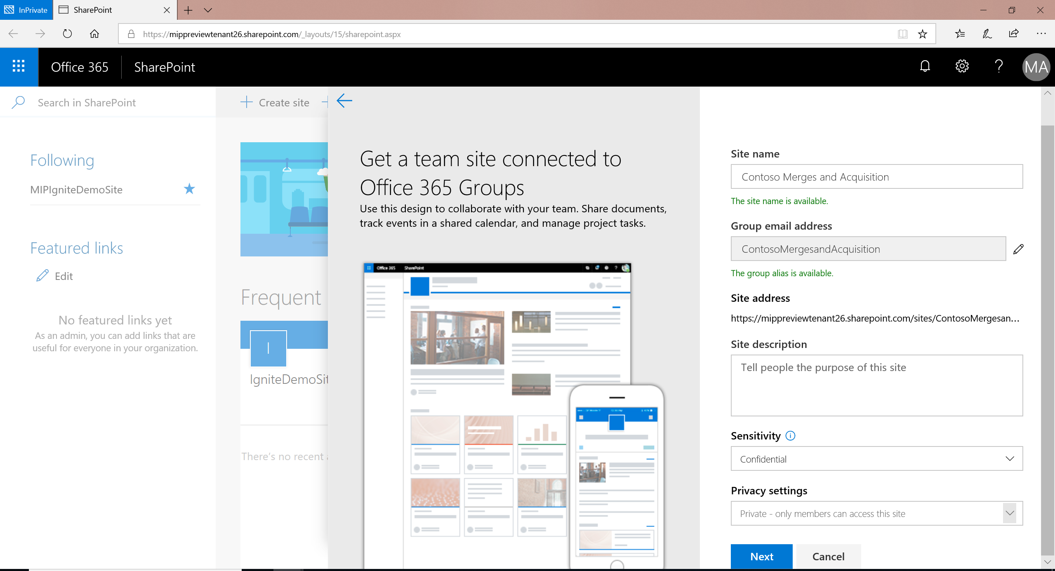
Preview EOY
Classifying SharePoint sites and Groups

Slide 55
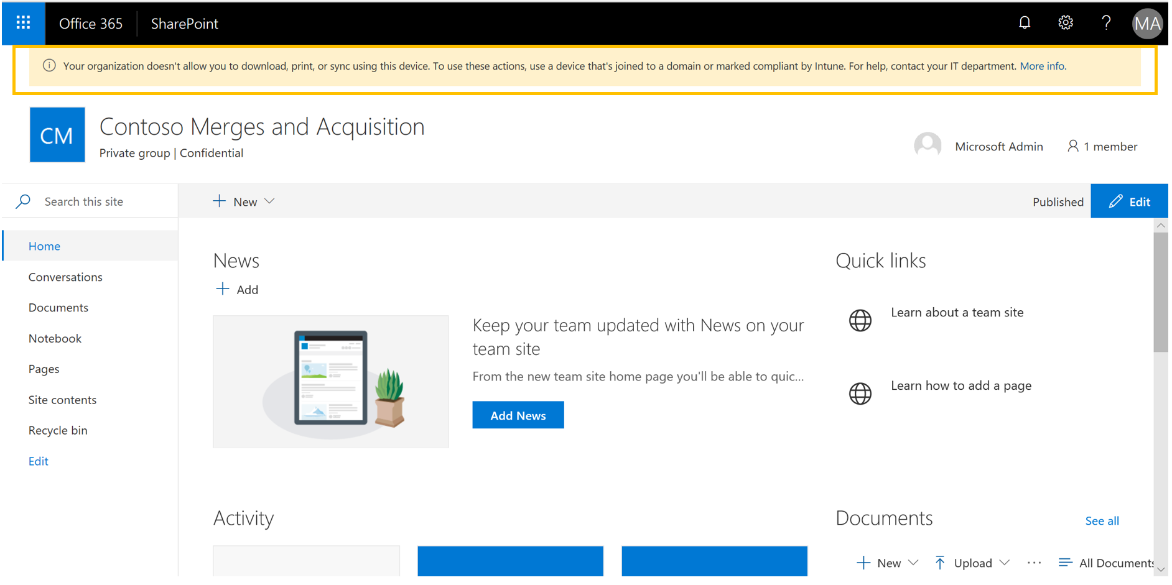
Preview EOY
Classifying SharePoint sites and Groups

Slide 56
Demo
SPO with retention labels

Slide 57
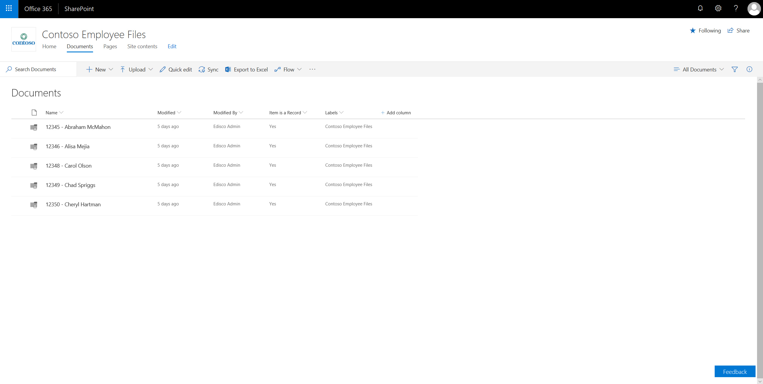
Available now

Slide 58
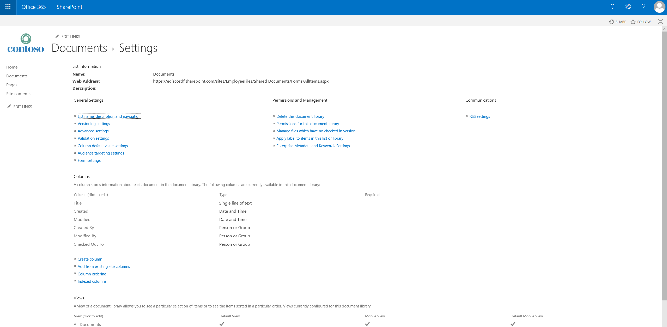


Slide 59
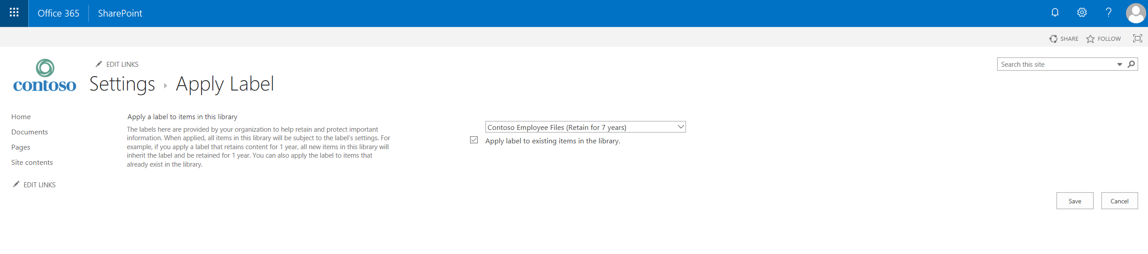

Slide 61
Demo
Extending MIP beyond Office 365

Slide 62
Comprehensive set of capabilities
AZURE INFORMATION PROTECTION
Classify, label & protect files – beyond Office 365, including on-premises & hybrid
CONDITIONAL ACCESS
Control access to files based on policy, such as identity, machine configuration, geo location
MICROSOFT CLOUD APP SECURITY
Visibility into 15k+ cloud apps, data access & usage, potential abuse
OFFICE APPS
Protect sensitive information while working in Excel, Word, PowerPoint, Outlook
OFFICE 365 DATA LOSS PREVENTION
Prevent data loss across Exchange Online, SharePoint Online, OneDrive for Business
MICROSOFT INFORMATION PROTECTION
SHAREPOINT & GROUPS
Protect files in libraries and lists
OFFICE 365 MESSAGE ENCRYPTION
Send encrypted emails in Office 365 to anyone inside or outside of the company
AZURE SECURITY CENTER INFORMATION PROTECTION
Classify & label sensitive structured data in Azure SQL, SQL Server and other Azure repositories
Discover | Classify | Protect | Monitor
WINDOWS INFORMATION PROTECTION
Separate personal vs. work data on Windows 10 devices, prevent work data from traveling to non-work locations
SDK FOR PARTNER ECOSYSTEM & ISVs
Enable ISVs to consume labels, apply protection
OFFICE 365 ADVANCED DATA GOVERNANCE
Apply retention and deletion policies to sensitive and important data in Office 365
ADOBE PDFs
Natively view and protect PDFs on Adobe Acrobat Reader

Slide 63

Windows devices integrate with MIP
Respect MIP labeling on Windows
Windows protects file based on MIP label
Prevent data from being accidentally copied to unmanaged apps and sites
Available starting with Windows 10 version 1809
Notes:
63

Slide 64
Demo
Windows + MIP

Slide 65

WIP – Copying Highly Confidential file to Personal One Drive

Slide 66

WIP – Copying Highly Confidential file to Gmail

Slide 67

WIP – Copying Highly Confidential file to USB Drive

Slide 68
Existing AIP customers
Unified labels are 100% interoperable with existing AIP labels
No need to re-create labels in SCC
No need to re-classify / re-label documents with AIP labels
New M365 E3 customer
M365 E5 (or) Existing AIP customer
Configure labels using the SCC portal
Try out labelling on Windows using the new MIP-enabled AIP add-in
Try out labelling on Mac, iOS, and Android using the Office native experiences
Configure labels using the AIP portal
Label on Windows using the AIP add-in with automatic labelling
Deploy the AIP Scanner to gain coverage over on-premises file stores
+
Try out labelling on Mac, iOS, and Android using the Office native experiences
Existing AIP
experience

Slide 69

Azure Information Protection scanner: Discover, classify & label files on-premises
Helps you manage sensitive data prior to migrating to Office 365 or other cloud services
Use discover mode to identify and report on files containing sensitive data
Use enforce mode to automatically classify, label and protect files with sensitive data
Can be configured to scan:
CIFS file shares
SharePoint Server 2016
SharePoint Server 2013
SharePoint Server 2010

Slide 70
AIP scanner demo
Demo

Slide 71




What is the AIP Scanner
Scans on-perm repositories: file shares, NAS or any other CIFS based repositories, or SharePoint Server
Discover data in the scanned repositories and match it against AIP policy (detect MCE sensitive info types, custom patterns and default label)
Labels and protects the discovered data per AIP policy
Create a report of discovered data, including the matched conditions
for found patterns

Slide 72

What do you need to discover your data
A server for the scanner and a database
A good network connection
An account that can access those repositories
Optional: labels and content type policies

Slide 73


Configure the AIP scanner
Discovery mode!
Constantly monitoring!

Slide 74

Monitor the scanner nodes at scale

Slide 75

Discover the data & sensitivity

Slide 76

Drill down to a file-level view

Slide 77

Automatically classify, label and protect files in cloud apps with Microsoft Cloud App Security
Detect content in cloud storage services
Inspect files for sensitive information – based on policy
Discover sensitive data across 3rd party clouds like SalesForce, Box, Dropbox and others.
Apply classification labels & protection
Automatically apply labels defined in Microsoft Information Protection to sensitive files discovered in cloud apps

Slide 78
Sample scanning rates
Based on a single Scanner server with 4 CPU Cores, scanning across a 1Gbps network (YMMV)
* In a repository of 100GB of already scanned files a new file is found in
Action | Discover | Label | Protect | Continuous discovery *
CIFS | 25-40 MB/s | 8-10MB/s | 4-5MB/s | 20 sec
SharePoint | 10-15MB/s | 3-4MB/s | 2-3MB/s | 50 sec

Slide 79
Demo
Microsoft Cloud App Security + Information Protection

Slide 80


Slide 82


Slide 83


Slide 84


Slide 85


Slide 86
Demo
M365 SCC analytics

Slide 87


Slide 88

Enhanced information protection analytics
In preview
Better visibility into classified, labeled and protected files – across workloads
Help identify information protection anomalies and risks
View by label type, service/app and label method (e.g. manual, automatic)
Recommendations to tune policy settings

Slide 89
Usage reports – Labeled items

Slide 90
Discover the data & sensitivity

Slide 91

Log Analytics

Slide 92
Data discovery – Repository level view

Slide 93
Roadmap
Now – 3 Months
3 – 6 Months
Unified Labeling in Office SCC (Now)
Unified Labeling in new M365 SCC (EOY18)
Labeling in Office apps on Mac and mobile (Preview now)
Labeling in Office apps on Windows (Preview EOY18)
Labeling in Outlook mobile (Preview EOY18)
Adobe PDF Preview and GA with MIP
Windows GA with MIP labels
MCAS + MIP GA
MIP SDK GA
AIP customers starting migration on pre-prod tenants
Partner ISVs going GA with MIP
Auto-classification for sensitivity outcomes
AIP customers migrate to using M365 SCC for admin experiences

Slide 94
Let’s meet
online
MIP…
FTW!!!!

